Slide 1
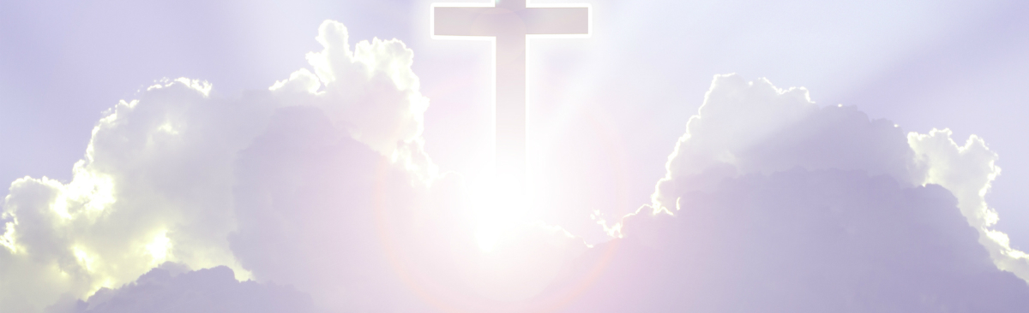
INTRODUCTION OF LESSON ONE ON SUNDAY
1-DEC-2024
INTRODUCTION: Basing on the year of chances and opportunity that God the Father gave us 2024, He added us another chance of a high calling such that apostle Ronald Hope Witness can take us into above heavens in the house of God the Father.
This was so after the message that God the Father gave to our Lord Jesus and the Holy Spirit “ tell that apostle to bring to me my children” meaning heading to Above the heavens.
But this can be a calling from God the Father which is termed as the high calling as spoken of in
PHILIPPIANS 3:14 I press toward the mark for the prize of the high calling of God in Christ Jesus.

Slide 2
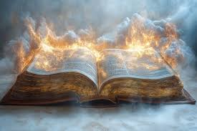
INTRODUCTION OF LESSON ONE ON SUNDAY 1-DEC-2024
Whenever God speaks of a high calling, it’s a calling from Above the heavens by God the Father who dwells above all the heavens according to Jeremiah 23:24 and Job28:23-24.
This high calling is different from the calling of Jesus and of Holy Spirit termed as the heavenly calling spoken of in
HEBREWS 3:1 Therefore, holy brethren, partakers of the heavenly calling, consider the Apostle and High Priest of our profession, Christ Jesus. So there are two types of godly callings, the high calling from God the Father and other heavenly calling of Jesus and Holy Spirit. And because of the above information, we head to look at:

Slide 3
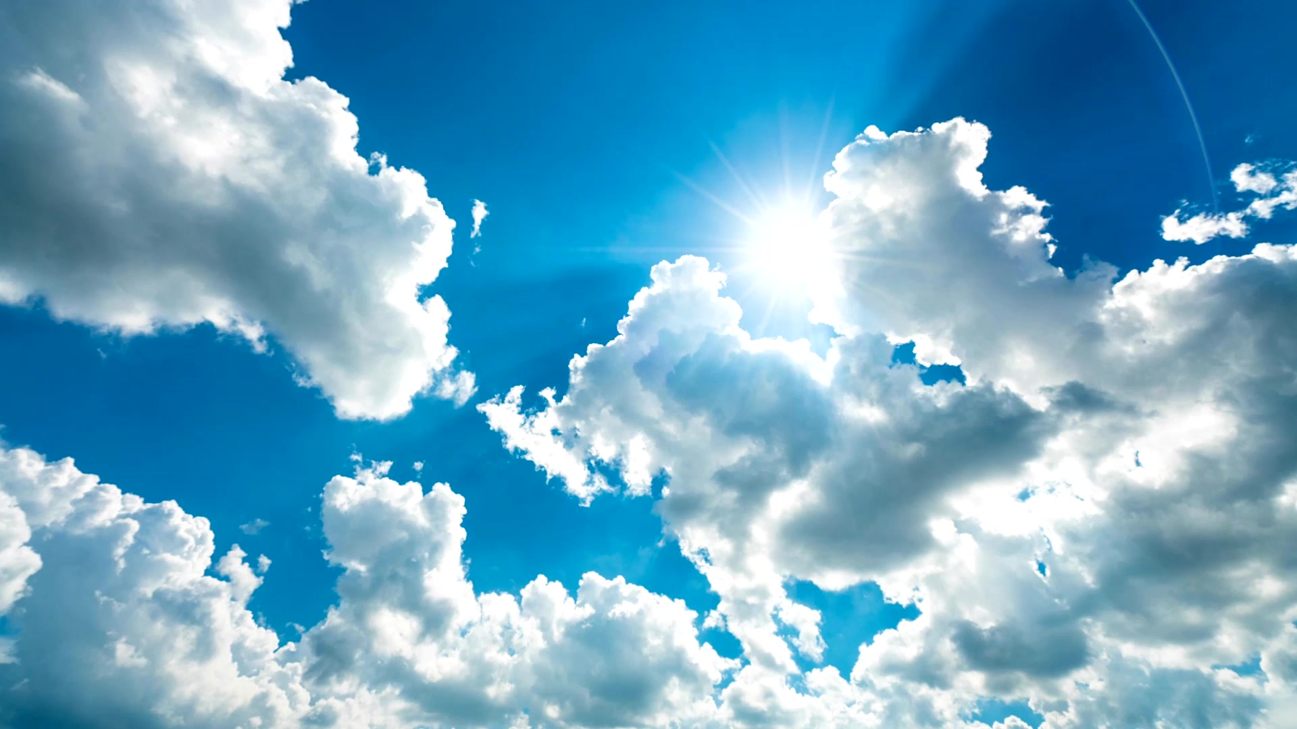
THE HEAVENLY JOURNEY AND THE SECRETS OF THE HEAVENS.
SUB TOPIC: ABOVE TTHEHE HEAVENS, AT THE BEGINNING BEFORE THE CREATION OF THE HEAboveAVENS AND EARTH.
NOTE: the heavens is the beginning before the creation

Slide 4
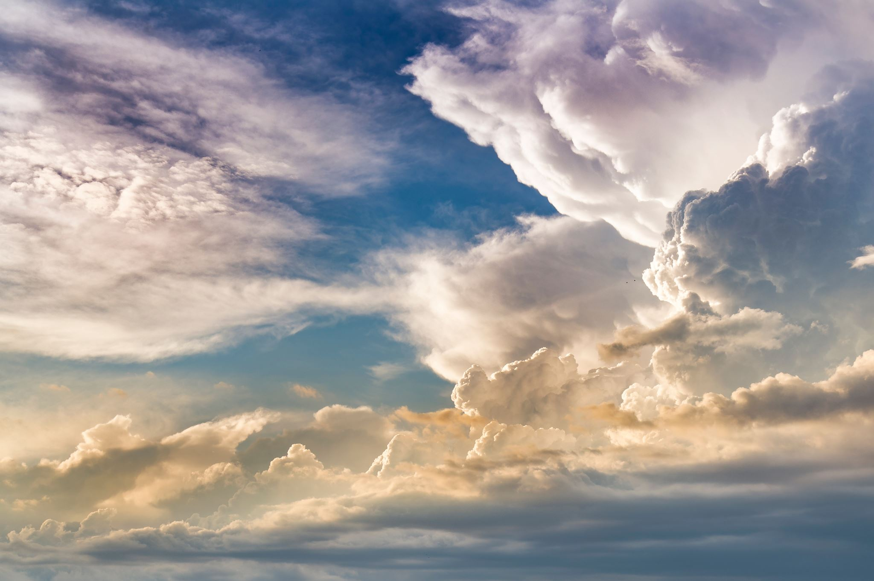
Above the Heavens Is The Beginning Where God Based To Create All Heavens And Fullness.
When ever we speak of the term “at the beginning”, its to understand the first chapter of the holy bible to answer the question of where was God before the creation of the heavens and the earth. Lets read
GENESIS1:1 In the beginning God created the heavens and the earth. This clearly shows that God was dwelling/based at the beginning to do creation but recall heaven and earth is the house of God yet none constructs a house when inside it but bases from its outside so at the beginning can not be in the heavens and earth then where is the beginning, a place in which God based in to create?

Slide 5
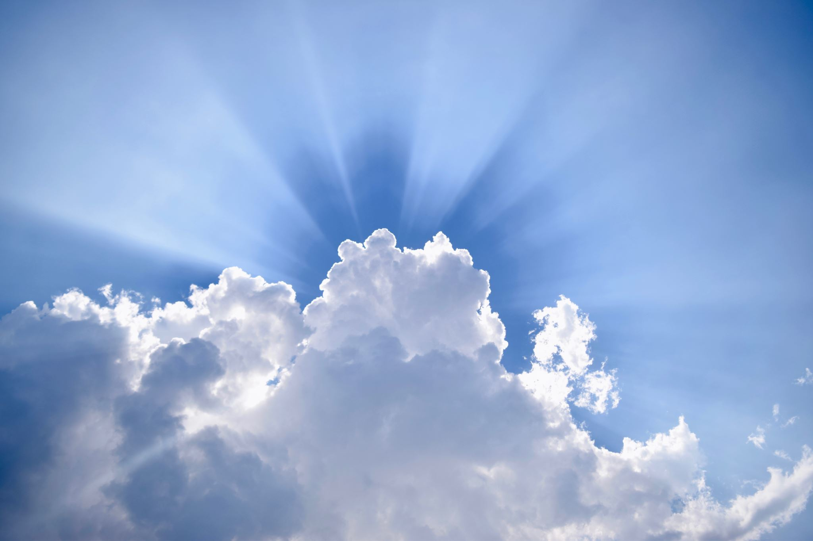
Above the Heavens Is The Beginning Where God Based To Create All Heavens And Fullness.
To answer this, the scriptures show that God the Father dwells above all the heavens and earth as well as their fullness according to
EPHESIANS 4:6 One God and Father of all, who is above all, and through all, and in you all. Truly God the Father dwells in the above of all things which is Above the heavens where He bases to look at all things through out the entire heavens as spoken in
JOB28:23-24 For he bases above, looks to the ends of the earth, and sees under all the heavens. This is the dwelling place of God the Father, Above the heavens and if we are to reach this place, we ascend from

Slide 6
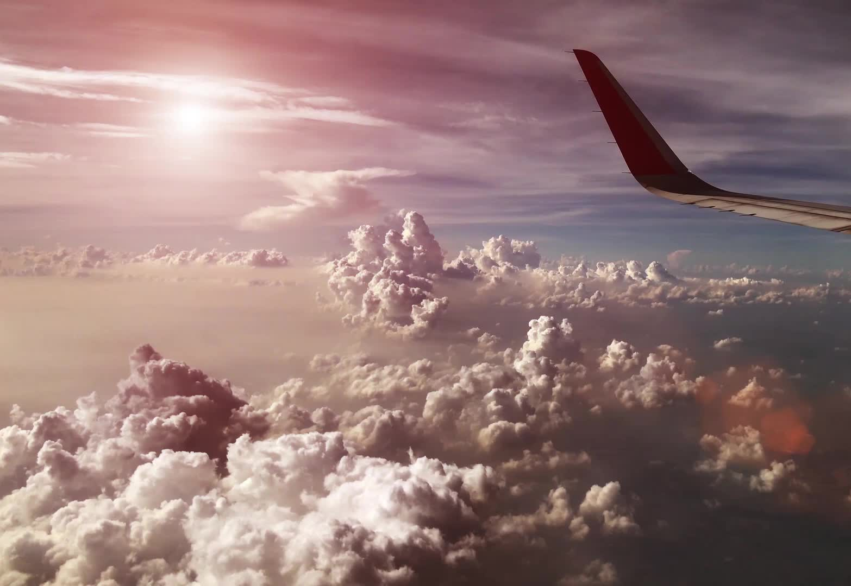
Above the Heavens Is The Beginning Where God Based To Create All Heavens And Fullness.
planet earth in the realms below to go out of the fourth created heaven, into the first created heaven, second created heaven into the third heaven at creation and once out of it, we enter Above the heavens at the beginning according to what we see in Ephesians when Lord Jesus was returning to the dwelling place of God the Father
EPHESIANS4:9 Now that he ascended, what is it but that he also descended first into the lower parts of the earth? When our Lord Jesus came on earth proved in John8:23 that we are in the lower parts/ realm below and to return to where he had come from, had to ascend back into the realms above John6:62 which thing he did in verse10

Slide 7
Above the Heavens Is The Beginning Where God Based To Create All Heavens And Fullness.
EPHESIANS4:10 He that descended is the same also that ascended up far above all heavens, that he might fill all things. Christ had told the disciples that was to ascend where he was before and once the process begun, it required him go above all the heavens that is why its said to reach above the heavens we have to go through out the entire heavens.
This was so because Christ had asked the Father to first return at the beginning which is above heavens in his first glory as the Word of God so by this we prove that indeed above the heavens is the beginning
Lets read.

Slide 8
Proving above heavens to be the beginning by looking at ascending time of Lord Jesus
JOHN17:4-5 I have glorified you on the earth: I have finished the work which you gave me to do. And now, O Father, glorify me with your own self with the glory which I had with you at the beginning before the world was. To say “glorify me with your own self with the glory which I had at the beginning” meant he was to go to the house of God the Father which thing he had told us in John14:1-2 such that they make counsels as it was before creation of heavens and earth according to John chapter one, three of them existing and making plans for creation
JOHN1:1-2 In the beginning was the Word, and the Word was with God, and the Word was God. The same was in the beginning with God.

Slide 9
Proving above heavens to be the beginning by looking at ascending time of Lord Jesus
In John17 Christ requested to return at the beginning in the glory he was in with God the Father meaning where they dwelt before creation but John1:1-2 shows that when they were at the beginning, Christ was God the Word with God the Father so when he was coming on earth for the missions in the created heavens, clothed flesh and appeared as a son leaving the initial glory of at the beginning according to
JOHN1:14 And the Word clothed flesh, and dwelt among us, (and we beheld his glory, the glory as of the only begotten of the Father,) full of grace and truth. Now the word who had came in the glory of the son Philippians 2:4-6 had completed the mission and required to be seen

Slide 10
Proving above heavens to be the beginning by looking at ascending time of Lord Jesus
Again as God the Word. When the time of returning at the beginning reached Christ entered above heavens proving it’s the beginning. Lets read
ACTS 1:9-10 And when he had spoken these things, while they beheld, he was taken up; and a cloud received him out of their sight. And while they looked steadfastly toward heaven as he went up, behold, two men stood by them in white apparel. It was evident that Christ was returning back to heaven but the disciples knew not the end point of his ascending so the angel had to explain to them in verse 11, lets read more on Acts.

Slide 11
Proving above heavens to be the beginning by looking at ascending time of Lord Jesus
ACTS1:11 Who also said, You men of Galilee, why stand you gazing up into heaven? this same Jesus, who is taken up from you into heaven, shall so come in like manner as you have seen him go into heaven. Recall that the prayer was to return at the beginning, more scriptures show on departing from earth in this acts on a cloud, continued the journey to reaching above the heavens according to
EPHESIANS4:9-10 (Now that he ascended, what is it but that he also descended first into the lower parts of the earth? He that descended is the same also that ascended up far above all heavens, that he might fill all things.)

Slide 12
Proving above heavens to be the beginning by looking at ascending time of Lord Jesus
Having reached above all the heavens, had reached at the beginning, the house of God the Father and there they made counsels that God the Father gave him as a revelation in the book of revelations to show what was to come and sent him to dwell first in the third created heaven reigning the current heavens and the earth.
To prove this, in this book of Revelation, we see that Christ was in his initial glory of the Word of God as the prayer request was according to
REVELATIONS19:11,13 And I saw heaven opened, and behold a white horse; and he that sat upon it was called Faithful and True, and in righteousness he does judge and make war. And he was clothed with a robe dipped in blood: and his name is called The Word of God.

Slide 13
Proving above heavens to be the beginning by looking at ascending time of Lord Jesus
So once in the above the heaven, at the beginning, some of the events there involved the great counsels sent to us as the book of revelations that once all things are done, Christ will return with us in Above the heavens at the beginning, Lets read in revelations
REVELATIONS1:1 The Revelation of Jesus Christ, which God gave unto him, to show unto his servants things which must shortly come to pass; and he sent and revealed it by his angel unto his servant John: God the Father gave him this message in the above the heavens at the beginning. Some one may doubt this but Christ had spoken about these things, the events to occur in the above heavens at the beginning and

Slide 14
Proving above heavens to be the beginning by looking at ascending time of Lord Jesus
the problem was that there was no space for all that information according to
JOHN16:12-14 I have yet many things to say unto you, but you cannot bear them now. But when he, the Spirit of truth, is come, he will guide you into all truth: for he shall not speak of himself; but whatsoever he shall hear, that shall he speak: and he will show you things to come. Among the many things were the things to occur when Christ reaches at the beginning and the scripture indicates were things to shortly come as revelations said that the revelations of Jesus that were shortly to come and above all Christ said it was the spirit to help us get

Slide 15
Proving above heavens to be the beginning by looking at ascending time of Lord Jesus
Revealed so its true because Revelations1:10 says, “I was in the Spirit on the Lord's day, and heard behind me a great voice, as of a trumpet”.
This is the spirit who was promised to us to reveal to us and what he brought was the book of revelation of Jesus Christ given to him by God the Father which is verses 14-15 if John chapter 16
JOHN16:14-15 He shall glorify me: for he shall receive of mine and shall show it unto you. All things that the Father has are mine: therefore, said I, that he shall take of mine, and shall show it unto you.
This connects well with Revelations1:1 that the revelation of Jesus that God the Father gave him, thus those of Father are of Christ so surely

Slide 16
Proving above heavens to be the beginning by looking at ascending time of Lord Jesus
of Christ. Having given him this revelation, God the Father told Christ to dwell in the third created heaven reigning heavens and the earth until all his enemies are thrown into hell. Lord Jesus had told us of this in Matthew that had been given authority in heaven and on earth. Lets read
MATTHEW28:18 And Jesus came and spoke unto them, saying, All power is given unto me in heavens and in earth. To do this, Christ the son of God, as God the Word is seated in the third heaven at creation according to
1CORINTHIANS12:2I knew a man in Christ fourteen years ago, (whether in the body, I cannot tell; or whether out of the body, I cannot tell: God knows;) such a one caught up to the third heaven. .

Slide 17
Ascend from our habitable planet earth to reaching above heavens at the beginning.
Having proven that Above heavens is the beginning, we want now to know how we ascend from our habitable planet earth to reaching above heavens to look at all what is there.
This is very vital to us that it helps us to know where we can meet God the Father in our prayers to answer the prayer of the Holy Spirit through Job as
JOB 23:3-4 Oh that I knew where I might find him! that I might come even to his seat! I would order my cause before him and fill my mouth with arguments. Recall that in John14:13-14 we pray to God the Father through the name of Jesus but to reach him, we need to mark well

Slide 18
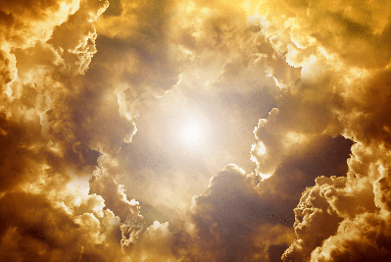
Ascend from our habitable planet earth to reaching above heavens at the beginning.
the way which requires us to ascend from the habitable earth where we dwell so let's ascend.
From the habitable earth where we dwell as.
ECCLESIASTES5:2 Be not rash with your mouth, and let not your heart be hasty to utter anything before God: for God is in heaven, and you upon earth: therefore, let your words be few. In our journey we find that all of us are just brought on this world according to what we read in
1TIMOTHY6:7 For we brought nothing into this world, and it is certain we can carry nothing out.

Slide 19
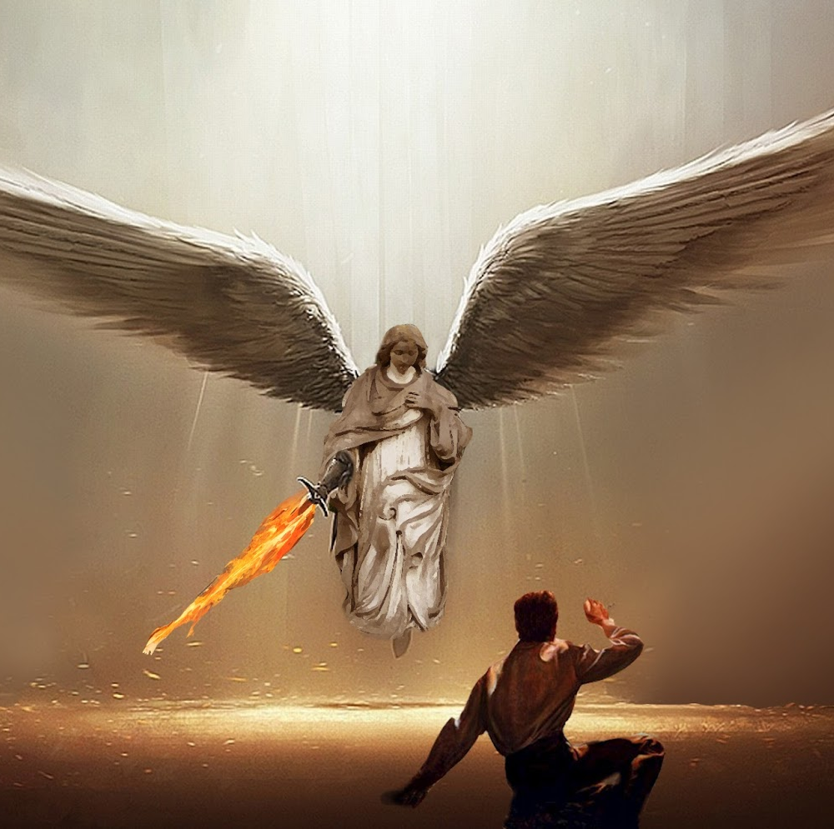
Ascend from our habitable planet earth to reaching above heavens at the beginning.
This means that we are passers by on this earth, our spirits are just brought on earth from the heavenly realms as the scripture confirms that our citizenship is in heaven
PHILIPPIANS 3:20 For our citizenship is in heaven; from which also we look for the Savior, the Lord Jesus Christ: There fore even though we are of heaven, we are brought on earth and if we are to return where the savior is, we base on this earth spoken of in proverbs
PROVERBS8:31 Rejoicing in the habitable part of his earth; and my delights were with the sons of men.

Slide 20
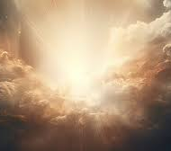
Ascend from our habitable planet earth to reaching above heavens at the beginning.
fore this matter if we are to go to above the heavens, ascending begins from here on earth.
b) From habitable earth, reach the other nine planets.
Once we get out of the doors of this earth, we meet other 9 planets that support no life/ non habitable spoken of in
2KINGS 23:5 And he put down the idolatrous priests, whom the kings of Judah had ordained to burn incense in the high places in the cities of Judah, and in the places round about Jerusalem; them also that burned incense unto Baal, to the sun, and to the moon, and to the planets, and to all the hosts of heaven.

Slide 21
Ascend from our habitable planet earth to reaching above heavens at the beginning.
These are more than one so in total are 10 planets and people burnt incense to them because behind the names of the planets are fallen angels the so-called gods that like being worshiped as
Acts 14:11-12 And when the people saw what Paul had done, they lifted up their voices, saying in the speech of Lycaonia, The gods are come down to us in the likeness of men. And they called Barnabas, Jupiter; and Paul, Mercury, because he was the chief speaker. It was the role of man to name these planets as in Genesis2, but fallen angels decided to give them their names such as Jupiter, Mercury, Pluto, Saturn, Venus, Neptune, Eris etc.

Slide 22

Ascend from our habitable planet earth to reaching above heavens at the beginning.
c) From these nine planets to reach the kingdom of the sun, moon, stars and hell.
These are not directly placed on the heaven but in the firmament of heaven according to what we read in
GENESIS1:14-17 And God said, Let there be lights in the firmament of the heaven to divide the day from the night; and let them be for signs, and for seasons, and for days, and years: These are far bigger than the planets and with in this kingdom we find hell which is the prison of God when we read
REVELATION9:1-2 And the fifth angel sounded, and I saw a star fall from heaven unto the earth: and to him was given the key of the bottomless pit.

Slide 23
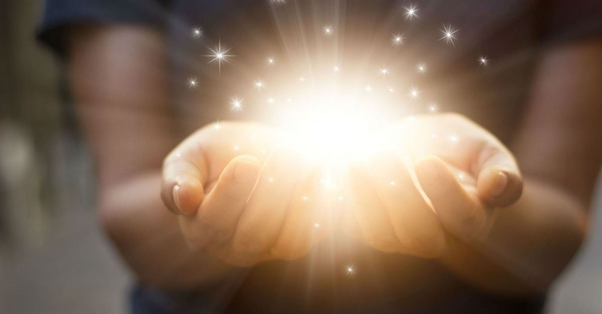
Ascend from our habitable planet earth to reaching above heavens at the beginning.
And he opened the bottomless pit; and there arose a smoke out of the pit, as the smoke of a great furnace; and the sun and the air were darkened by reason of the smoke of the pit. When you open hell, the sun can not give light because of the smoke from hell meaning these are with in the same region. Not only the sun but also the stars that is why its said in Matthew24:29 the sun shall be darkened, and the moon shall not give its light, and the stars shall fall from heaven, and the powers of the heavens shall be shaken: all the above are in the firmament of the fourth heaven at creation so as we ascend we pass this kingdom but hell is not in the ground as many people think.

Slide 24
Ascend from our habitable planet earth to reaching above heavens at the beginning.
In the same kingdom, we find the principalities, the devils who made there, their major camp according to
EPHESIANS6:12 For we wrestle not against flesh and blood, but against principalities, against powers, against the rulers of the darkness of this world, against spiritual wickedness in heavenly places. The heavenly places where these devils/principalities dwell is not heaven itself because Revelations12:7 shows thy were cast out of heaven and no place for them was left but this is in the kingdom of stars where they constructed cities and caves as
OBADIAH1:4

Slide 25
Ascend from our habitable planet earth to reaching above heavens at the beginning.
The fact that they constructed their major base in the stars, those who worship them on earth are given these symbols like sun, stars and the moon to show where their gods are seated and the most important part for them to be in this place, it's easy for the angel of death and hell to imprison them in the warfare prayer. Briefly that is that kingdom and once out of it.
d) From the kingdom of the stars, sun and moon to reach the blue heaven in the realm below.
This fourth heaven at creation is very far from the habitable Earths
ISAIAH55:9 For as the heavens are higher than the earth, so are my ways higher than your ways, and my thoughts than your thoughts.

Slide 26
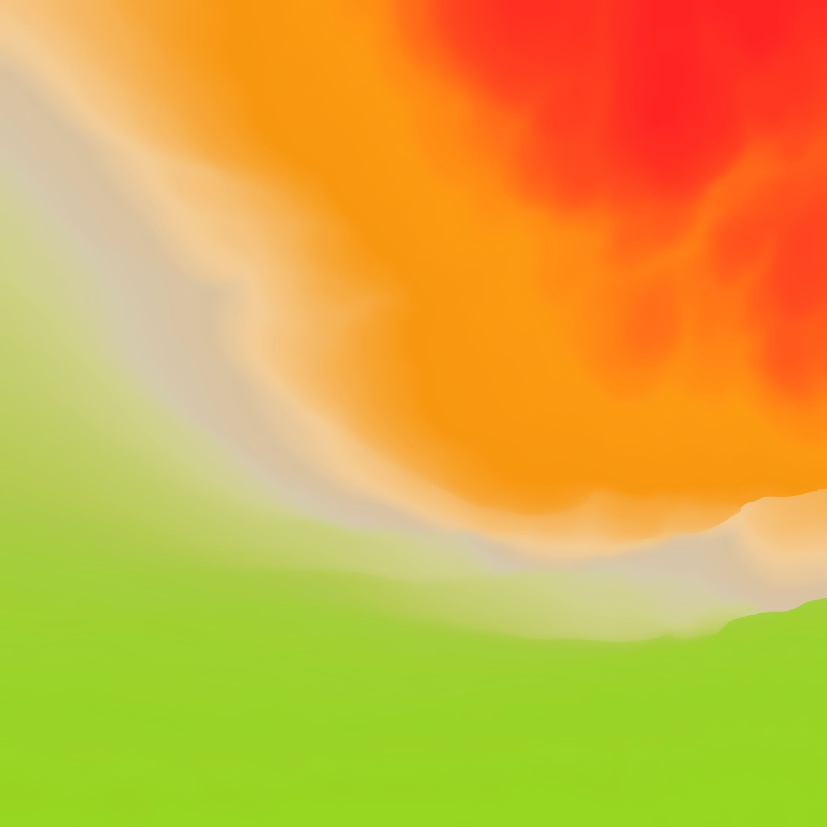
Ascend from our habitable planet earth to reaching above heavens at the beginning.
The fact that this heaven is very far, scientists failed to reach it and termed it a universe, some thing that ends not but God through his spiritual transports takes his children back into heaven like a dream, vision and others as spoken of in
JOB20:8 He shall fly away as a dream, and shall not be found yea, he shall be chased away as a vision of the night. The scientists have always ended in the kingdom of the stars by the aid of the technology of the fallen angels as Isaiah47, but no binocular can see things to heaven. The holy angels usually use azotus/teleportation to descend from heaven and ascend back according to what we read in

Slide 27

Ascend from our habitable planet earth to reaching above heavens at the beginning.
GENESIS28:12 And he dreamed, and behold a ladder set up on the earth, and the top of it reached to heaven: and behold the angels of God ascending and descending on it. We see that these ladders are with in the azotus and these stretched from the northern door of the fourth heaven at creation to the northern door of the habitable earth.
This heaven is circular in shape meaning it encloses all the components we have looked at before, lets read
JOB22:14 Thick clouds are a covering to him, that he sees not; and he walks in the circle of heaven.

Slide 28
Ascend from our habitable planet earth to reaching above heavens at the beginning.
This heaven being circular is found in all regions and directions. This was the last created heaven that we see in
GENESIS1:8 And God called the firmament Heaven. And the evening and the morning were the second day. God never created one heaven but heavens even though according to this verse he was on the last created heaven as evidenced by chapter two of genesis
GENESIS2:1Thus the heavens and the earth were finished, and all the host of them. God made more than one heaven and in total are four heavens counted in the book of Deuteronomy, lets read.
DEUTERONOMY 10:14

Slide 29
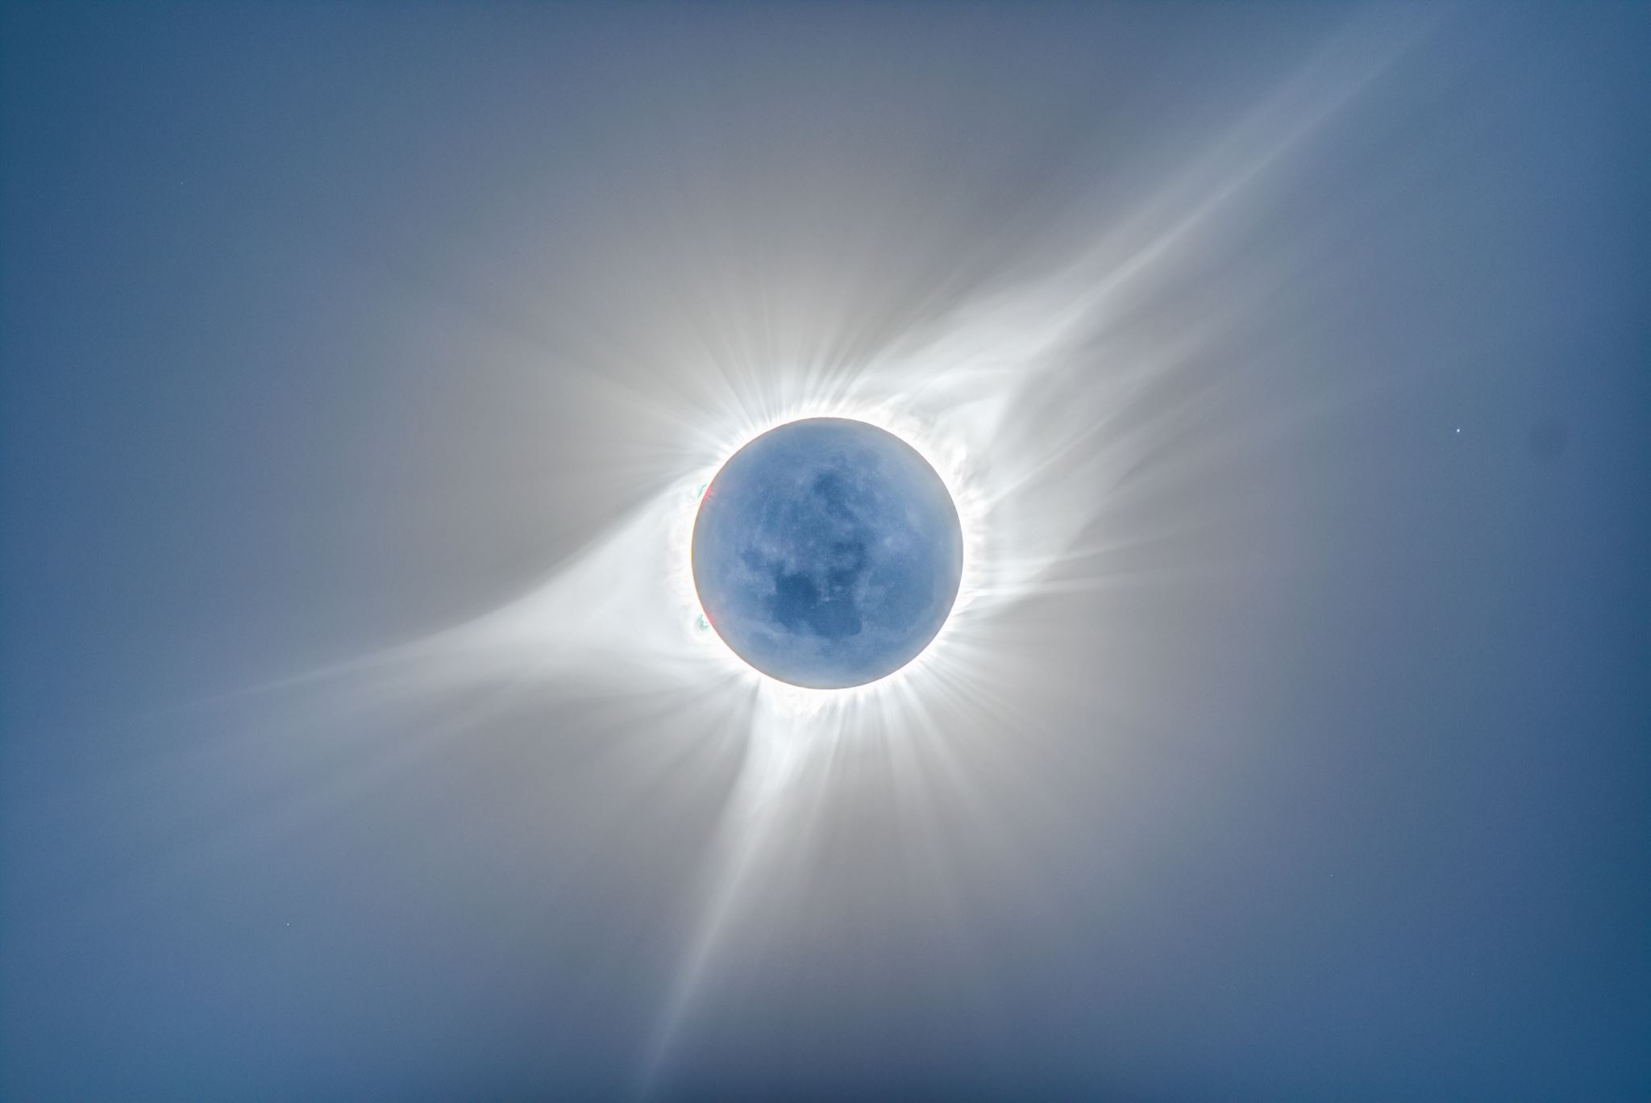
Ascend from our habitable planet earth to reaching above heavens at the beginning.
Heaven and heaven is (1+1=2) of is (multiply by) heavens (two) and at the end we see its (1+1)*2=4 heavens.
e) Then we pass through the northern door of the fourth heaven into the southern door of the first created heaven in the realm above. The heaven with the heavenly Jerusalem city with the numerous angels and holy ones.
This can be proven by the fact that, we saw the holy angels coming from the next heaven down on earth and ascending back to heaven from earth according to
GENESIS28:12 And he dreamed, and behold a ladder set up on the earth, and the top of it reached to heaven: and behold the angels of God ascending and descending on it.

Slide 30
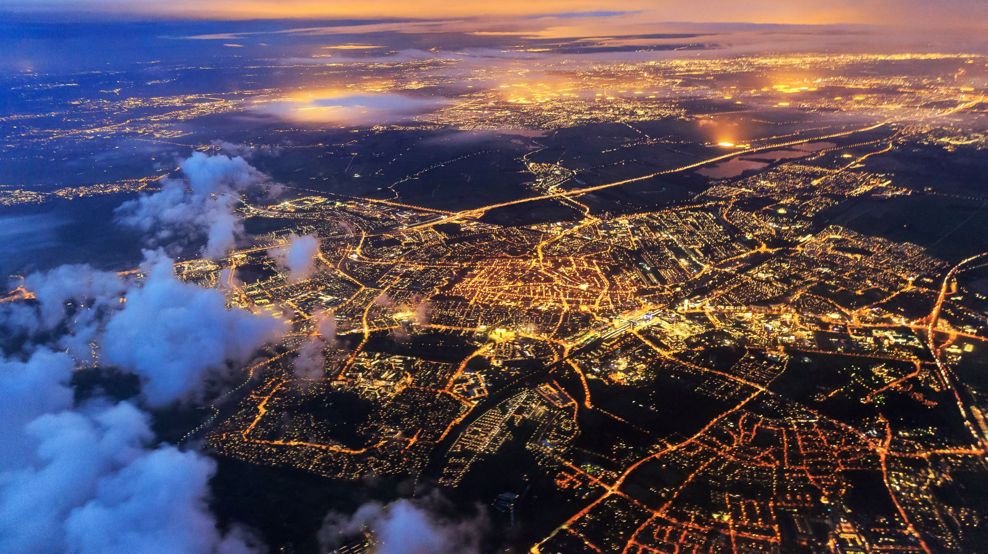
Ascend from our habitable planet earth to reaching above heavens at the beginning.
We see that these angels came down on earth and then ascended back to heaven, then the question is, where did they come from? It's from the heavenly Jerusalem city of God according to
HEBREWS12:22 But you are come unto mount Zion, and unto the city of the living God, the heavenly Jerusalem, and to an innumerable company of angels. To be called heavenly, means that it’s a city found not on earth but in heaven and specifically in the first created heaven. Not only angels are in this city but also all the righteous people who are done with the earthly life according to Luke16:19-23. these are the places that Christ went to prepare in John14:3.

Slide 31
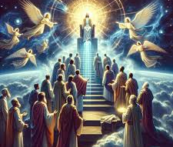
Ascend from our habitable planet earth to reaching above heavens at the beginning.
f) From the first created heaven, we ascend into the second created heaven where we find the four living creatures and the mountains and hills of musical instruments of worshiping God.
To begin on this heaven, its said that heavens are opened not heaven as
EZEKIEL 1:1 Now it came to pass in the thirtieth year, in the fourth month, in the fifth day of the month, as I was among the captives by the river of Chebar, that the heavens were opened, and I saw visions of God. Why heavens opened if we need to enter the second heaven, the northern doors of two heavens, fourth and first have to get opened.

Slide 32
Ascend from our habitable planet earth to reaching above heavens at the beginning.
And once they are opened, what is seen are the living creatures which are the stores of all spirits that are brought here on earth, lets read
EZEKIEL1:5 Also out of its midst came the likeness of four living creatures. And this was their appearance; they had the likeness of a man. We find God telling the holy ones in Revelations6:9-12 to go rest until their fellow servants also and their brethren, that should be killed as they were, should be fulfilled. The issue is on from where? These come from the living creatures/heaven as Philippians3:20 on to the earth and once they complete their mission on earth return back to heaven. See

Slide 33
Ascend from our habitable planet earth to reaching above heavens at the beginning.
ZECHARIAH5:7 And, behold, there was lifted up a cover of lead: and there was a woman that sits in the midst of the basket. The spirits are carried by the angels of counsel in their special baskets and placed into the wombs to be clothed with flesh as Job10:8-10 so in summary we have to pass through this heaven if we are to reach above the heavens.
g) From here we ascend more into the third heaven at creation in the realms above where we find the throne of God and the garden of God. This is spoken of in
2CORINTHIANS 12:2-5 I knew a man in Christ fourteen years ago, (whether in the body, I cannot tell; or whether out of the body, I cannot tell: God knows;) such a one caught up to the third heaven. How that he was caught up into paradise, and heard unspeakable words,

Slide 34
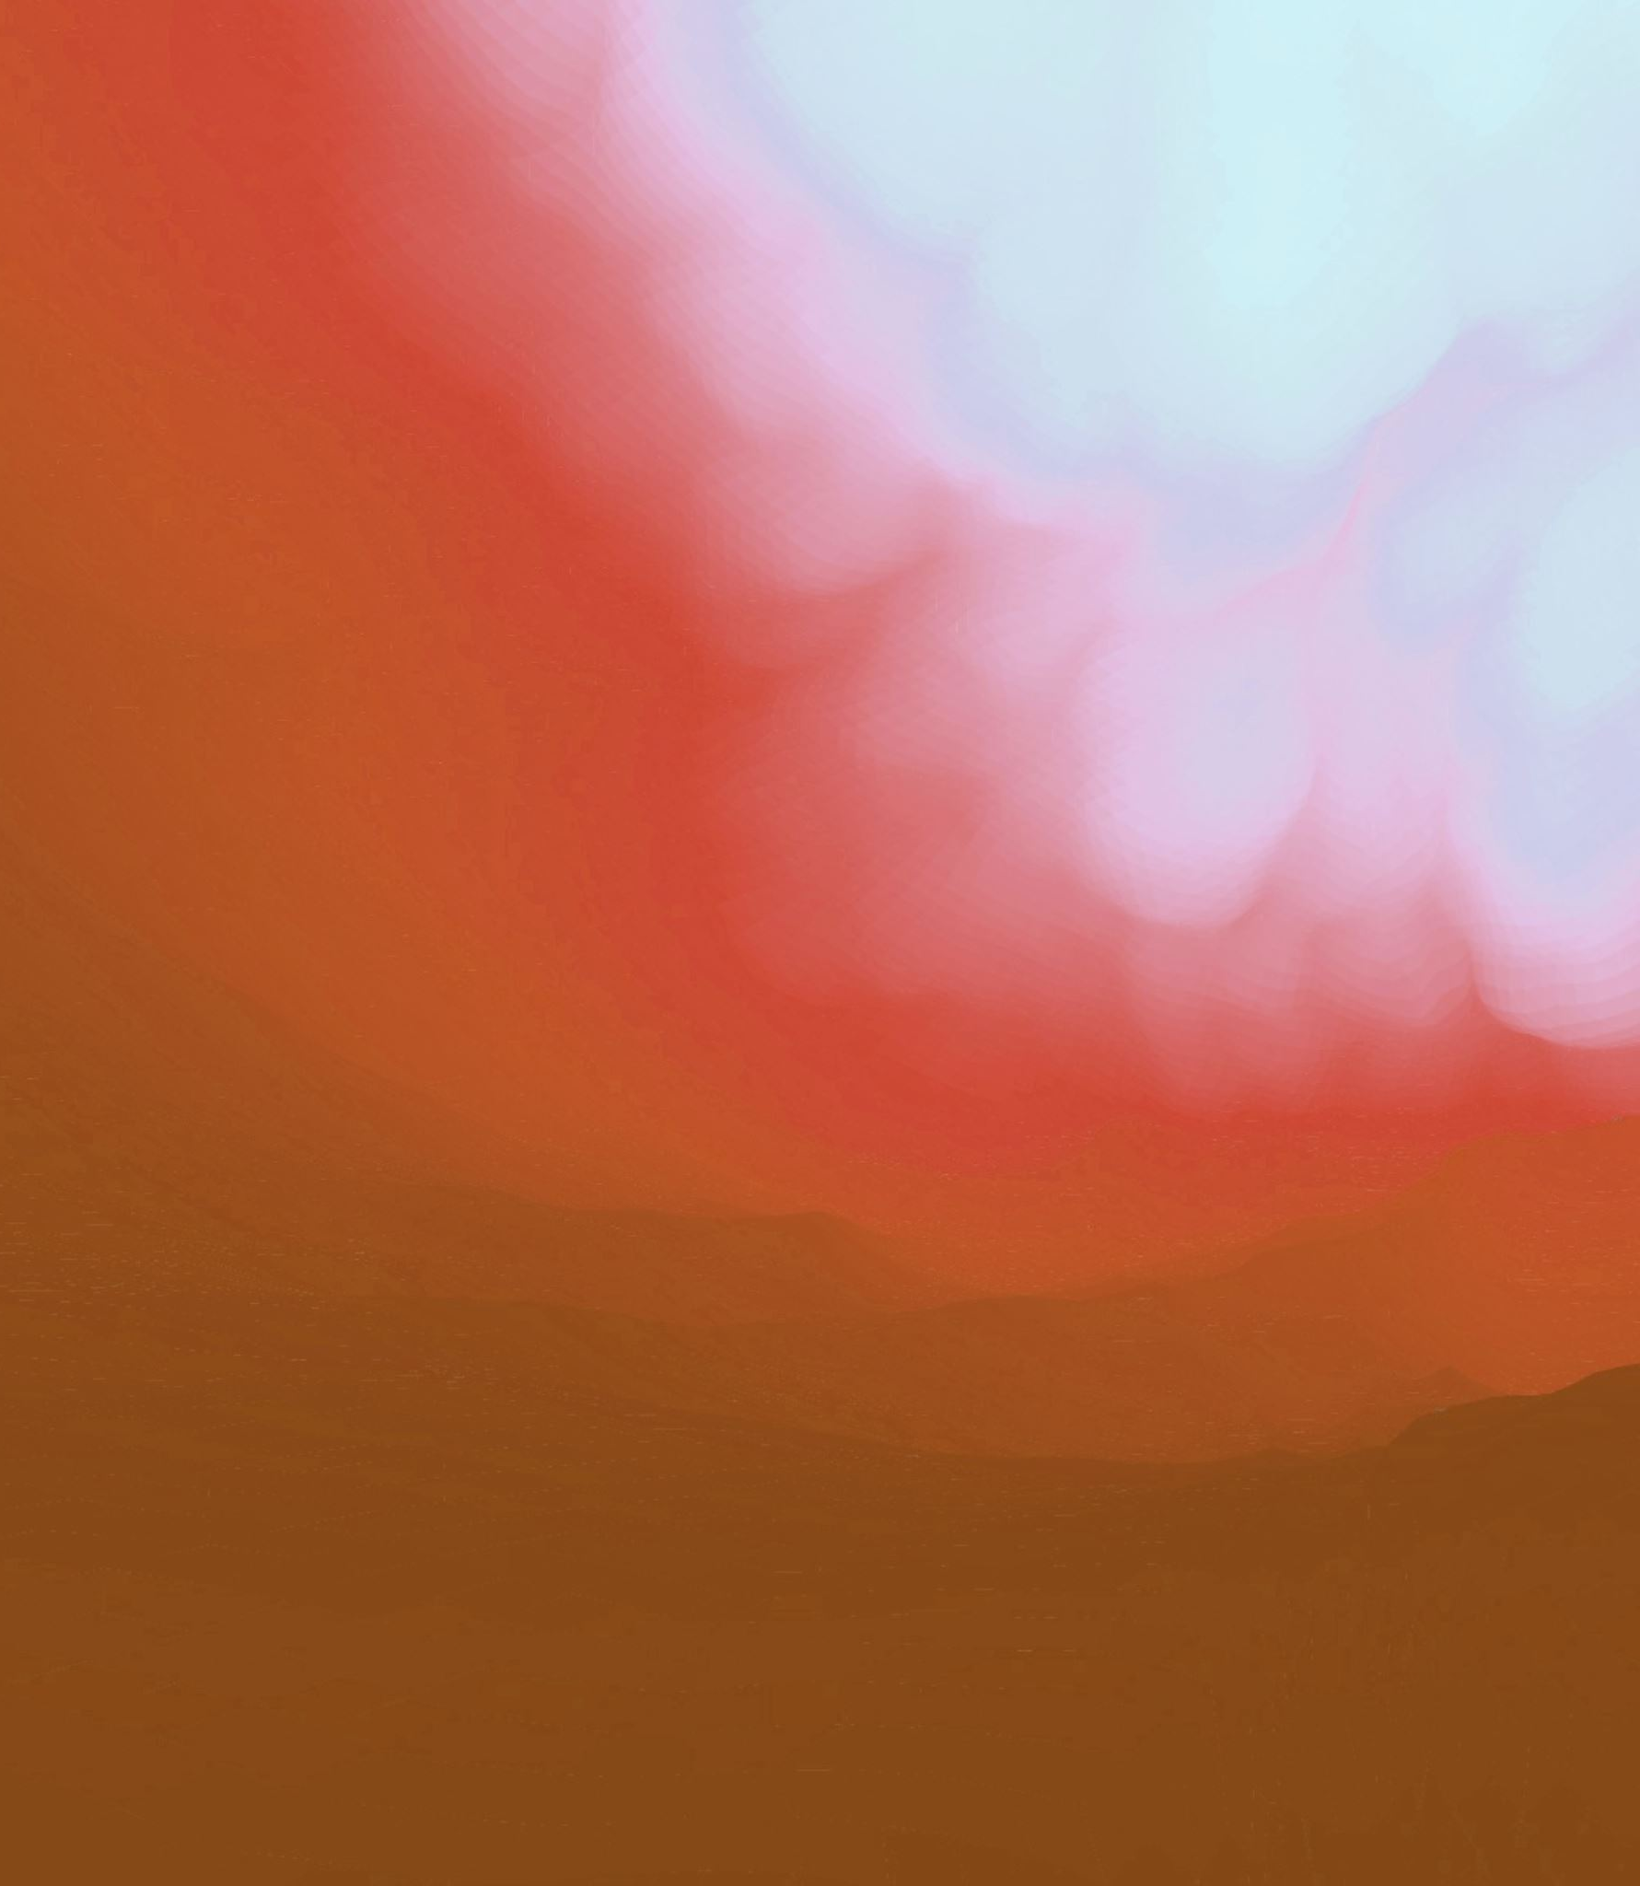
Ascend from our habitable planet earth to reaching above heavens at the beginning.
This one was in the third heaven meaning you have to be with first and second to reach the third and it is with in this third heaven that we find the throne of God according to
REVELATIONS4:2 And immediately I was in the spirit; and, behold, a throne was set in heaven, and one sat on the throne. This throne being in heaven, scriptures show that its above the second heaven with the living creatures thus in the third, lets read.
EZEKIEL 1:26 And above the firmament that was over their heads was the likeness of a throne, as the appearance of a sapphire stone: and upon the likeness of the throne was the likeness as the appearance of a man above upon it.

Slide 35
Ascend from our habitable planet earth to reaching above heavens at the beginning.
Once they say, above the firmament, its to mean above that heaven leading you into another next heaven so here in the third heaven, we have the throne of God the Word.
h) From the third created heaven in the realm above, we ascend through the northern door to reach above the heavens just as in Ephesians.
EPHESIANS4:9-10 (Now that he ascended, what is it but that he also descended first into the lower parts of the earth? He that descended is the same also that ascended up far above all heavens, that he might fill all things.)

Slide 36
Ascend from our habitable planet earth to reaching above heavens at the beginning.
That is how we can mark the way/path towards above the heavens, they are the ancient paths that for a long time satan had removed from the mind set of people.
JEREMIAH 31:21 Set up signposts, make yourself landmarks: set your heart toward the highway, even the way which you went: turn again, O virgin of Israel, turn again to these your cities. Its is not easy to find and think of this path that many people leave this world and find it strange when they land into hell.
JEREMIAH22:10 Weep not for the dead, neither bemoan him: but weep bitterly for him that goes away: for he shall return no more, nor see his native country.

Slide 37
Ascend from our habitable planet earth to reaching above heavens at the beginning.
Our crying should be on the spirits that have to return to God but not the body that remains here on earth dead so in all God through his apostle has blessed us with the order of all these things which is
ISAIAH44:7 And who, as I do, shall call, and shall proclaim it, and set it in order for me, since I appointed the ancient people? And the things that are coming, and shall come, let them show these unto them.

Slide 38
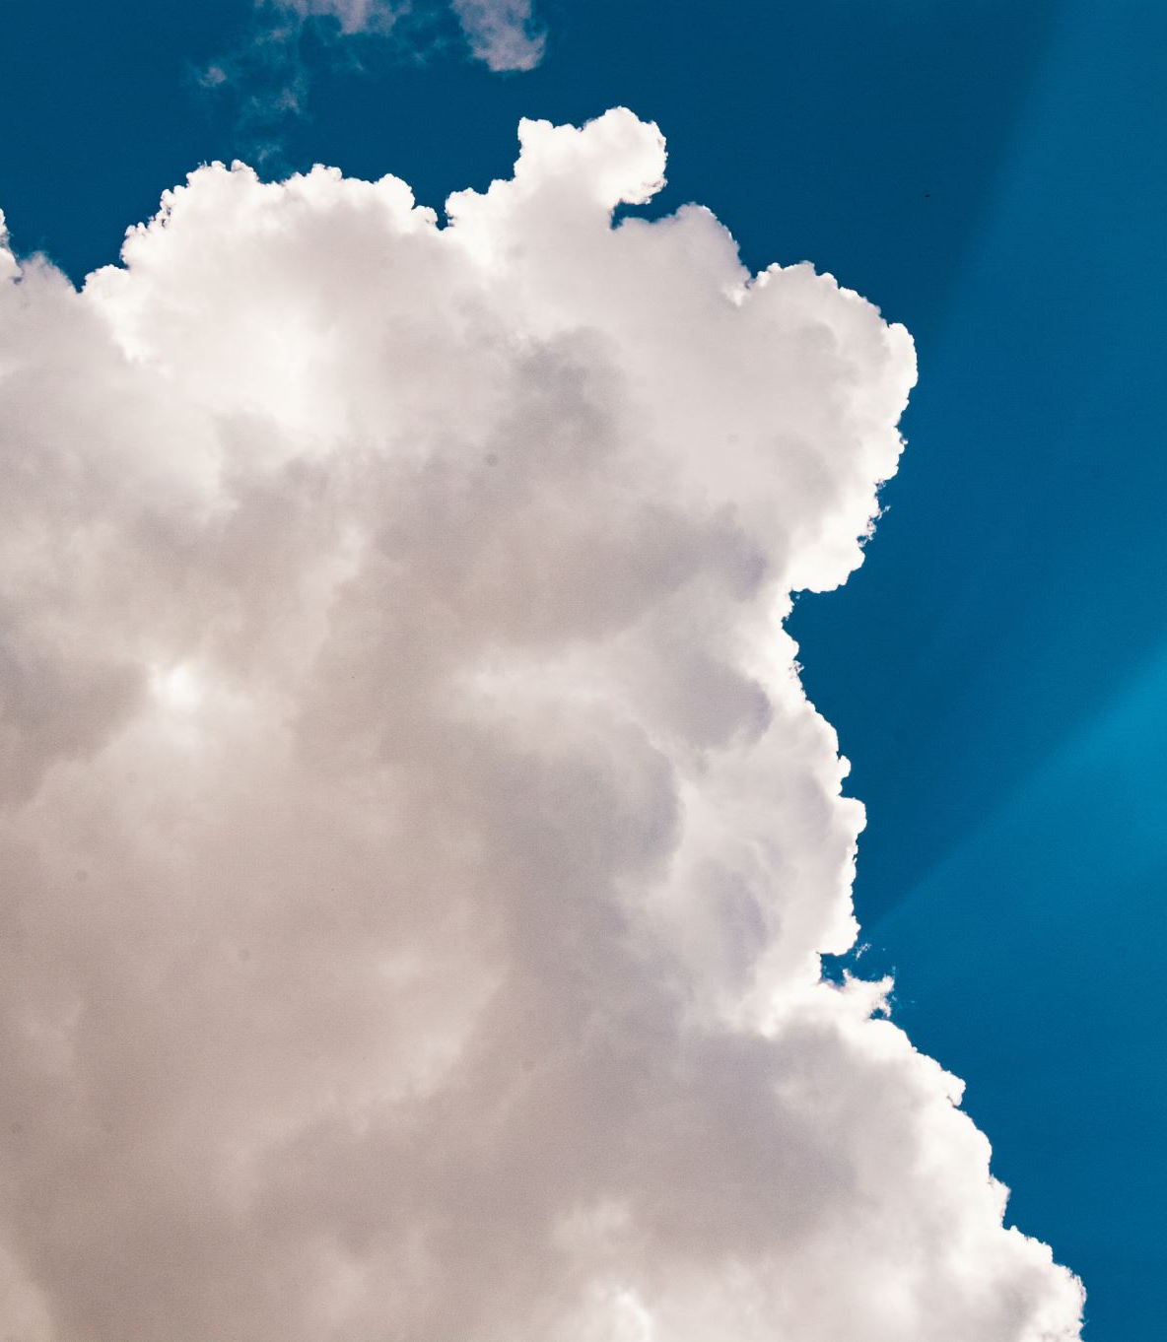
4-DEC-2024 LESSON2: ABOVE THE HEAVENS.
We are continuing with the heavenly journey and secrets of heaven. And today we are going to look at one of the important things in above the heavens which is:
GOD IS THE BEGINNING AND THE END, THE FIRST AND THE LAST, THE ALPHA AND THE OMEGA, GOD WHO WAS AND WHO IS TO BE.
Still looking at chapter one, verse one of Genesis.
GENESIS1:1 In the beginning God created the heavens and the earth. Having reached above the heavens and discovered it’s the beginning where God based to create all things, then another question rises, who put in place the beginning? This should be the beginning who is God.

Slide 39

God the Father is the beginning and the end, the first and the last, the alpha and the omega, god who was and who is to be..
God being the beginning and the end, the first and the last, alpha and omega who was and will be above all the heavens.
Let’s hear of God the beginning and the end, first and last, alpha and omega
REVELATIONS22:13 I am Alpha and Omega, the beginning and the end, the first and the last. This means that nothing is found above the heavens apart from God the Father.
NOTE: It's not that God is at the beginning and end of a condition like poverty, but God himself is the beginning and end.
This implies all those who call themselves god have a lower mind than that of a pig that forgets and feeds on its stool and young ones, for they can not ask themselves what heaven and earth they created at their beginning.

Slide 40
God the Father is the beginning and the end, the first and the last, the alpha and the omega, god who was and who is to be
God being the beginning called everything at the beginning as the first and last according to
ISAIAH41:1 Who has performed and done it, calling the generations from the beginning? I the LORD, the first, and with the last; I am he. God was able to call/create the generations of heavens and their fullness as Genesis2:4 basing in Himself as the beginning as still the scripture in Ephesians1:3-4 that He chose us and called us a holy calling in Christ Jesus.
We continue to see that God or redeemer, is the alpha and the omega according to what we read in chapter 44 if Isaiah. Lets read

Slide 41
God the Father is the beginning and the end, the first and the last, the alpha and the omega, god who was and who is to be
ISAIAH44:6 Thus says the LORD the King of Israel, and his redeemer the LORD of hosts; I am the first, and I am the last; and besides me there is no God. This clearly shows that at the beginning is God the Father who was and the end because all things are to be removed and end in Him thus the God to be/come. This is why Jeremiah 23 is right that :
JEREMIAH23:23 Am I a God at hand, says the LORD, and not a God afar off? How far is now known that its above the heavens and this is God the Father.
NOTE: With this full knowledge, to backslide and return to full foolishness that is not measured by the scales of heaven as in

Slide 42
God the Father is the beginning and the end, the first and the last, the alpha and the omega, god who was and who is to be
Daniel 5:27. so to return to our topic God fills all the heavens that once you go out of heavens the rest is God the Father.
JEREMIAH23:24 Can any hide himself in secret places that I shall not see him? says the LORD. Do not I fill heaven and earth? says the LORD. To fill up something is when you have enclosed it completely therefore once God is called God who was, its to say with out the heavens and earth, was the one present and once these heavens are removed, we find only him thus the God the end. God being above the heavens makes him be above all circumstances and conditions so we can not compare him to anything as the holy spirit said in ACTS17:25-27.

Slide 43
God the Father is the beginning and the end, the first and the last, the alpha and the omega, god who was and who is to be
JOB28:24 For he looks to the ends of the earth, and sees under all the heavens. To look through the entire heavens means you are above them and fill them and since its the case with God, He has eyes that he can zoom to focus all things that nothing remains hidden to him as Hebrews4:13 and Psalms139::12. God the Word, Jesus Christ continues to speak him too is the beginning and end.
REVELATIONS1:8 I am Alpha and Omega, the beginning and the ending, says the Lord, who is, and who was, and who is to come, the Almighty.
God who is, is God the Word who is in the third heaven whose fullness is made by the current heavens yet God who was and to come is God the Father but Jesus can also be this because before creation was with

Slide 44
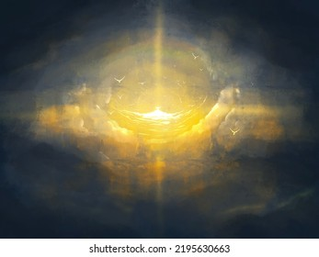
God the Word is the beginning and the end, the first and the last, the alpha and the omega, god who was and who is to be
The Father as John1:1 yet when the current heavens are removed is to return in above heavens to reign with God the Father so this explains why even Christ is the beginning and end, Alpha and omega, the first and the last.
REVELATION21:6 And he said unto me, It is done. I am Alpha and Omega, the beginning and the end. I will give unto him that is thirsty of the fountain of the water of life freely.
On the other hand, the Holy Spirit is also the beginning and end, Alpha and omega as we hear in the book of Genesis that all existed at the beginning as the beginning

Slide 45
God the Holy Spirit is the beginning and the end, the first and the last, the alpha and the omega, god who was and who is to be
GENESIS1:1-2 In the beginning God created the heavens and the earth.
And the earth was without form, and void; and darkness was upon the face of the deep. And the Spirit of God moved upon the face of the waters.
Since the spirit was there at the beginning with God the Father and God the Word, Jesus Christ, was sent and all things were created as
PSALMS104:30 You send forth your Spirit, they are created: and you renew the face of the earth. This was all at the beginning and because of this, the three are the witnesses that bear records of things at the beginning thus all the beginning as

Slide 46

The Three Witness are the Beginning and the End, Alpha and Omega, First and the Last.
1JOHN5:7 For there are three that bear witness in heaven, the Father, the Word, and the Holy Spirit: and these three are one. Therefore, the two came from one who is God the Father, so God is the beginning and the end, Alpha and Omega, first and the end.
Conclusion: God the Father, God the Word and God the Holy Spirit is the beginning and the end in the above the heavens.

Slide 47
5-DEC-2024 LESSON3: ABOVE THE HEAVENS.
Even now we want to continue with the heavenly journey and the secrets of heavens
SUBTOPIC: Above the heavens, at the beginning before the creation of the heavens and the earth.
This time round we want to study
GOD THE CREATOR, CREATING ALL THINGS BASING IN THE ABOVE ALL THE HEAVENS.
We are still in Genesis1:1 and we want to know the God who created the heavens and earth such that we totally do away with those who claim to be god yet not, for they will never live. Let's read

Slide 48
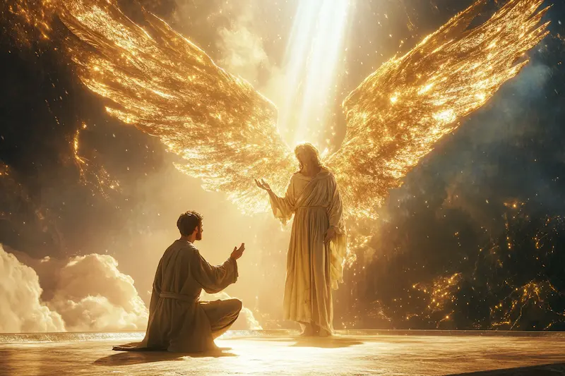
Only God the Father, God the Word and God the Holy Spirit is God the Creator and no other gods.
GENESIS1:1 In the beginning God created the heavens and the earth. The scripture is very clear that God is the creator so however claims to be God should show us his heavens and their content, failure to do so, those are the false gods that will never live as the true God says
NOTE: If the creator of heavens and earth is God the Father, God the Word, Jesus Christ together with the Holy Spirit known as the spirit of the Lord, then other so-called gods who never created the heavens and earth exist not and will never be. Let's read
JEREMIAH 10:11Thus shall you say unto them, The gods that have not made the heavens and the earth, even they shall perish from the earth, and from under these heavens.

Slide 49
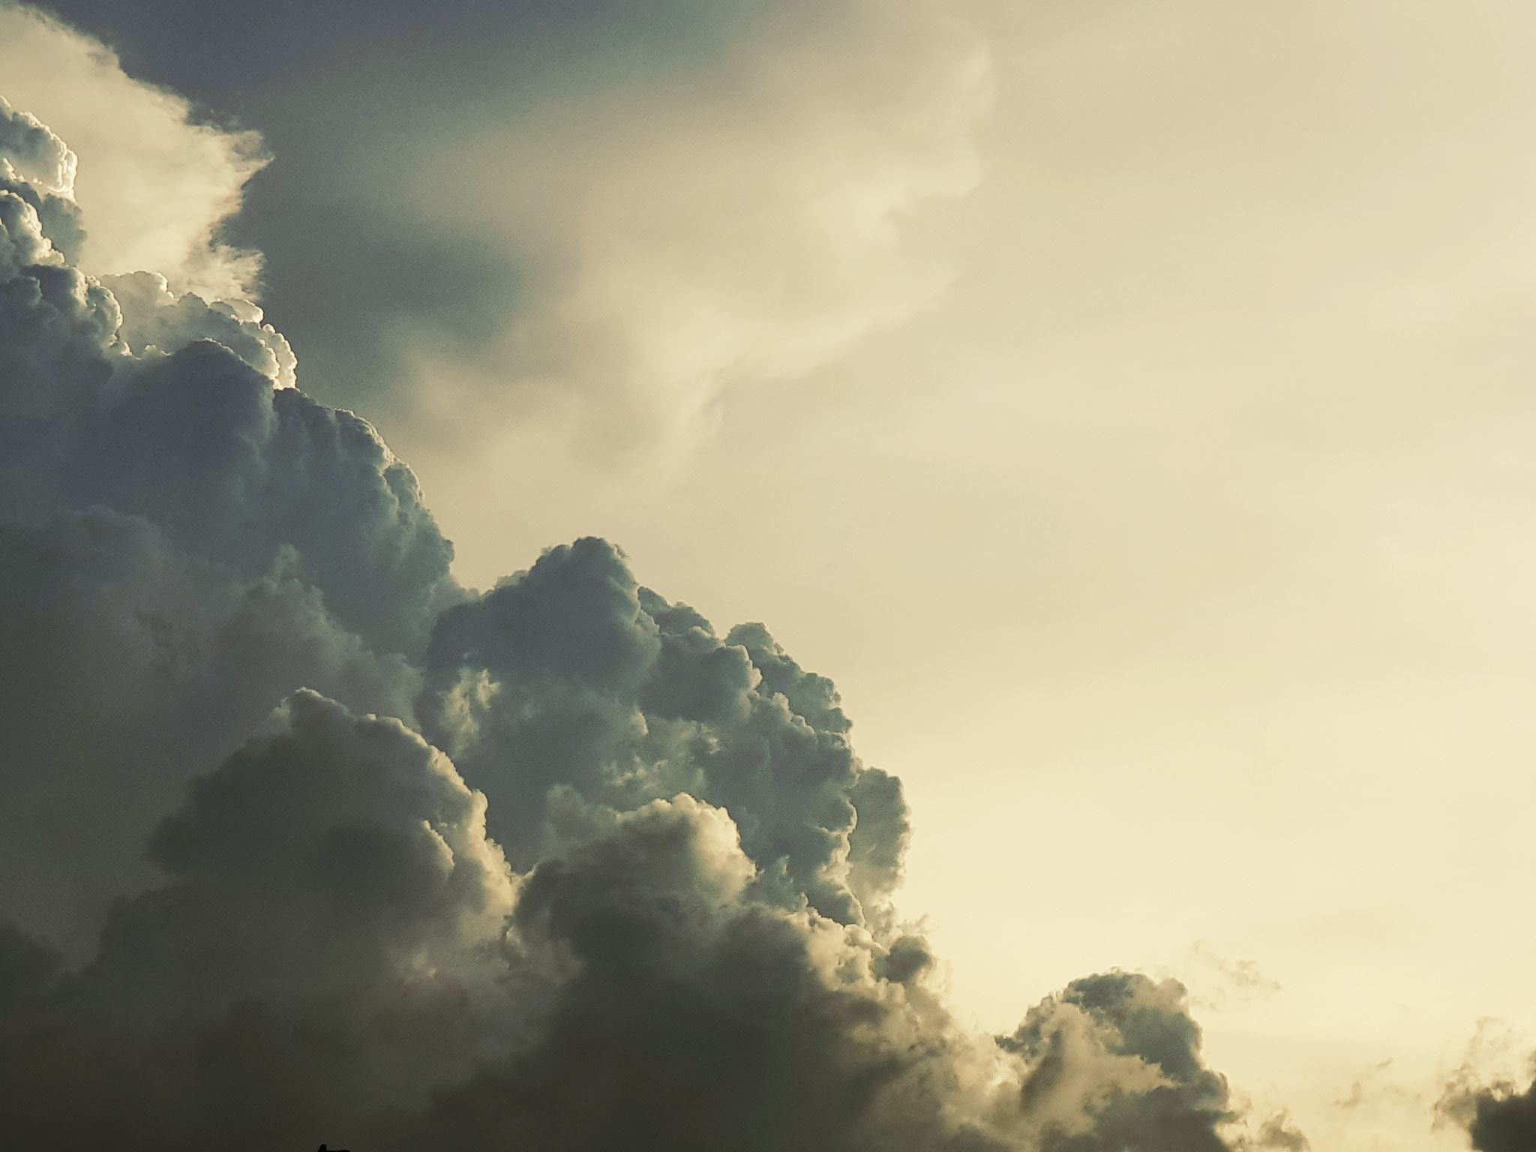
Only God the Father, God the Word and God the Holy Spirit is God the Creator and no other gods.
When we speak about God, we want only the one who made the heavens and things below the heavens and earth, then too those who never created heavens and earth can not be god and will never live but perish and pass away.
God is not a title but a role of creating so its not to any one who may claim it on earth and in the heavens as we hear the scripture that there are many so called gods. These are not insects, birds, animals but the devils, fallen angels and some sons of men who joined satan and all became un usual creatures (ebimongwa) lets read;
1CORINTHIANS8:5 For though there be those called gods, whether in heaven or in earth, (as there be gods many, and lords many,)

Slide 50
Only God the Father, God the Word and God the Holy Spirit is God the Creator and no other gods.
To be called, the so-called gods means they are not truly gods but just imposing to be gods because its evident they never created any thing and some who use magic to make things like beans and eats, the first one to create many beans and causes growth of tones ever since the cultivation begun is God. So let us go to great works of creating heavens and earth because knowledge about the creator is not among the humans which results into destruction. Let's read verse six
1CORINTHIANS8:6 But to us there is but one God, the Father, of whom are all things, and we in him; and one Lord Jesus Christ, by whom are all things, and we by him. The only God is God the Father, God the Word who is Lord Jesus and the Holy Spirit because they created the

Slide 51
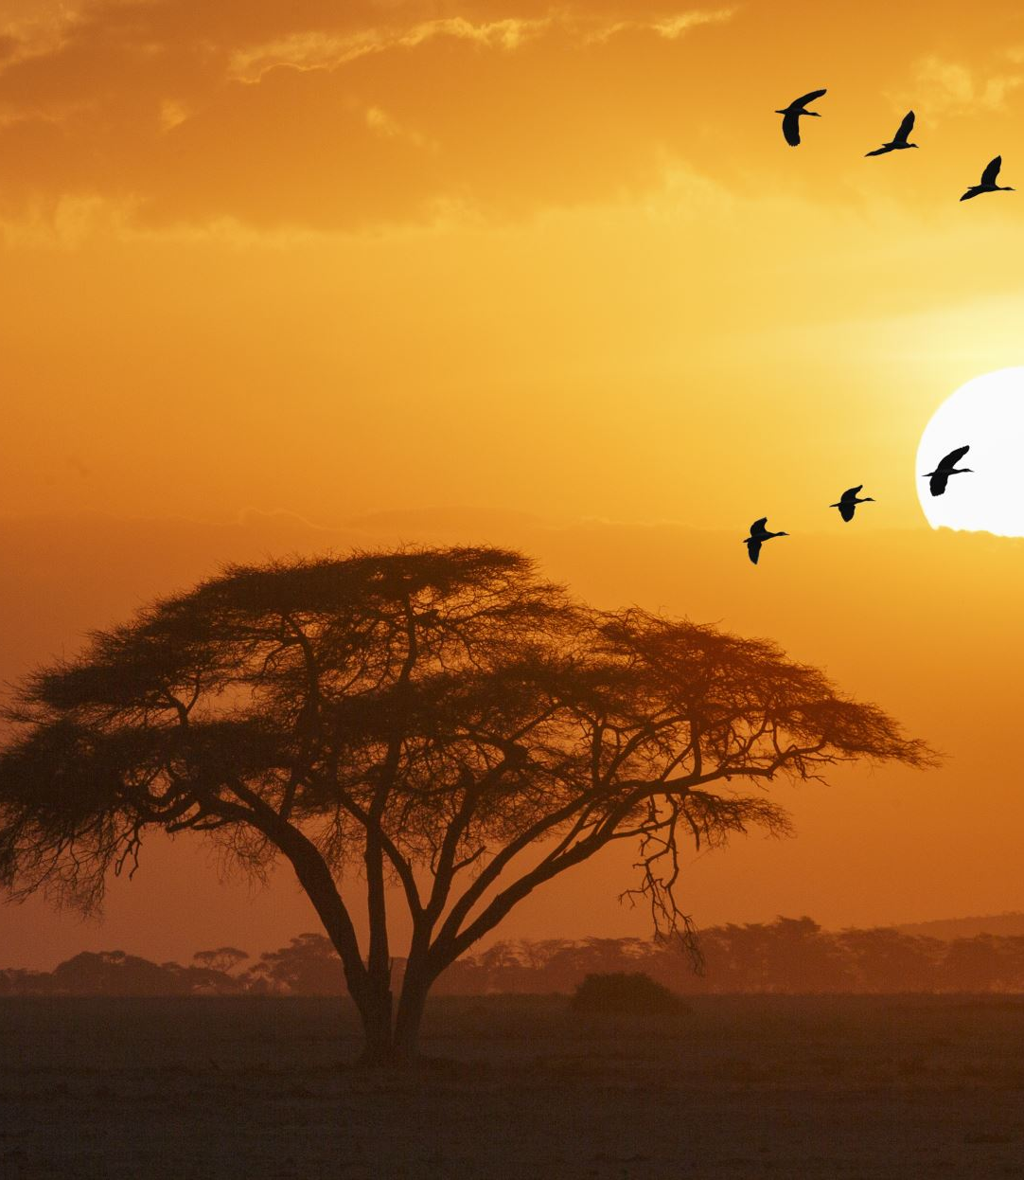
Only God the Father, God the Word and God the Holy Spirit is God the Creator and no other gods.
heavens and the earth so people like Bisaka in Uganda east Africa have great problems, they can not show there beginning and the heavens the created, but we see them dying like animals. Let's recap
1CORINTHIANS8:6 But to us there is but one God, the Father, of whom are all things, and we in him; and one Lord Jesus Christ, by whom are all things, and we by him. The God we have is God the Father who is in above the heavens as Ephesians4:6 and one Lord Jesus Christ by whom all things were created according to John1:1-4 that with out him nothing was created.
The reason why the so-called gods are not and will never, the real gods are the children of God because God gives birth to gods as Psalms82:6

Slide 52
But the Knowledge of Only God the Father, God the Word and God the Holy Spirit is God is Not in All .
But you find this knowledge on the only true God is not among humans according to what we read in
1CORINTHIANS8:7 But there is not in every man that knowledge: for some with conscience about the idol unto this hour eat it as a thing offered unto an idol; and their conscience being weak is defiled. This explains that indeed those with a mind set that are god, they have a weaker mind than young children because those with knowledge know only true God. To know God, widens our minds that even though we go in the shrines and death ceremonies we can eat food and get not corrupted because in our minds we know those are not gods.

Slide 53
But the Knowledge of Only God the Father, God the Word and God the Holy Spirit is God is Not in All .
NOTE: Its very important to know God as the creator of heavens and the earth than the names that people struggle to speak like Yaweh, Joshua etc. this is what God told Moses that I AM WHAT AM, for he is God the creator, God says in Jeremiah9:24 that those who boast and glory, should do it because they know Him.
Due to lack of this knowledge among people, it has brought in much destruction and because of the Full Knowledge International Ministries this knowledge has to spread through out the world to cut off the much tortures and destruction spoken of in
ISAIAH11:9 They shall not hurt nor destroy in all my holy mountain: for the earth shall be full of the knowledge of the LORD, as the waters cover the sea.

Slide 54
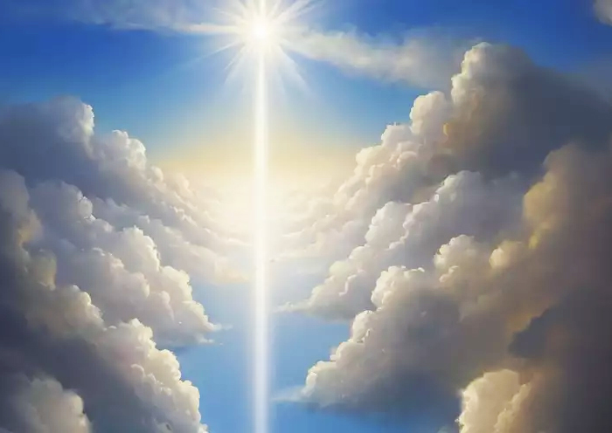
God Through the Full Knowledge International Ministries has Brought this Full Knowledge.
Hurting is wide that it involves suffering of hell and lack of fire but this is all about worshiping what they do not know Hosea4:6 so once we get this knowledge of the only true God and Jesus Christ, its removes since this knowledge is eternal life according to John17:3.
It’s the blessing of the Full Knowledge of God International to end this destruction as spoken and promised of God according to:
PSALMS78:6 That the generation to come might know them, even the children who should be born; who should arise and declare them to their children: These had to get born and heads get disturbed by the fathers in the false knowledge about God, then as today rising occurs to get the full knowledge about God to attain the nature like this:

Slide 55
God Through the Full Knowledge International Ministries has Brought this Full Knowledge.
PSALMS78:7 That they might set their hope in God, and not forget the works of God, but keep his commandments: One of the qualities of these children is to know God and all his works like creating the heavens and earth and their fullness and not being like their fathers in the next verse
PSALMS78:8 And might not be as their fathers, a stubborn and rebellious generation; a generation that set not their heart aright, and whose spirit was not steadfast with God. These are people who used to backslide and turn back to the gods who never created heaven and earth, worshiping them and offering sacrifices onto them

Slide 56
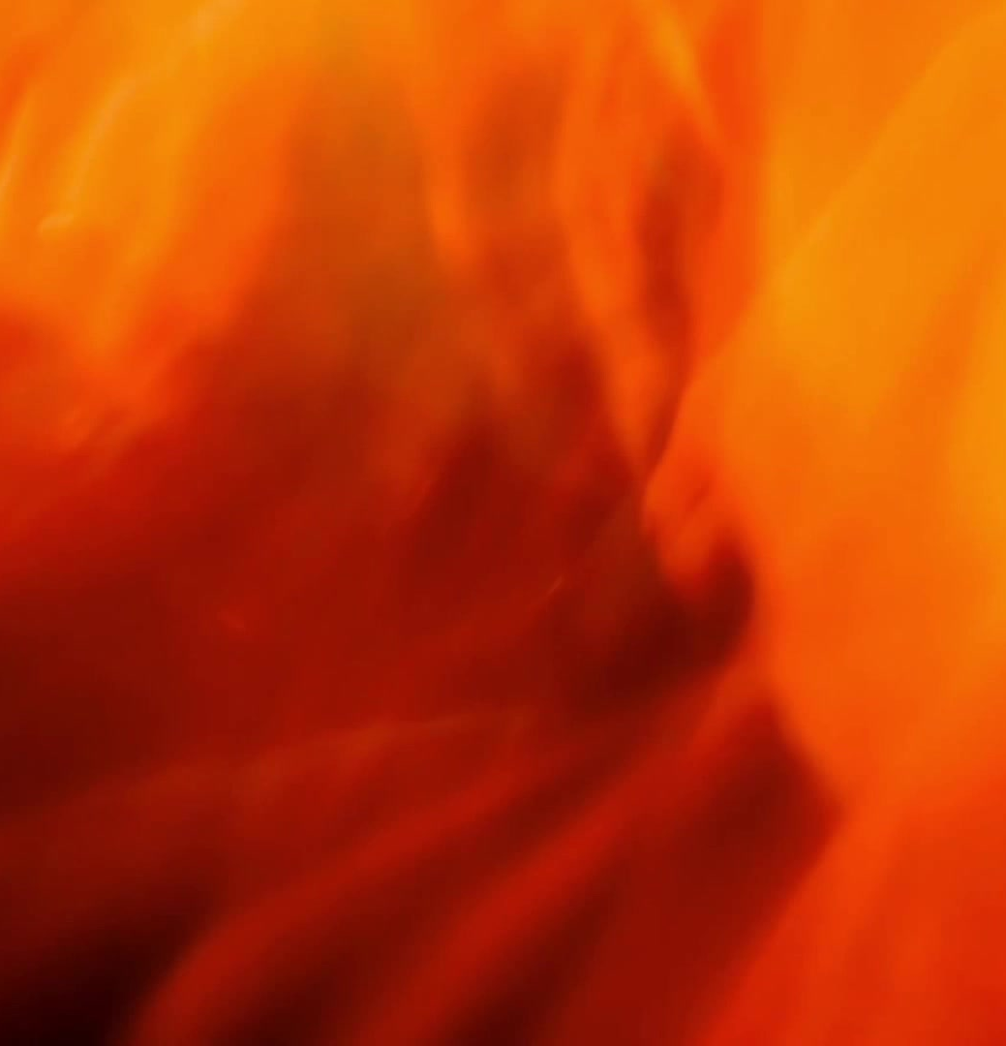
The So-Called Gods was Started By Satan Known as Lucifer who Lifted up his Heart to Be God Yet Not.
However, this was started by satan who first lifted his heart and said is God yet not. Let's read of this in
ISAIAH14:12-13 How are you fallen from heaven, O Lucifer, son of the morning! how are you cut down to the ground, who did weaken the nations! For you have said in your heart, I will ascend into heaven, I will exalt my throne above the stars of God: I will sit also upon the mount of the congregation, in the farthest sides of the north: Even though this one was a cherub, in his hearth thought that was a god yet was just created by God so these are the so called gods that exist not and will perish from heaven and below heavens.

Slide 57
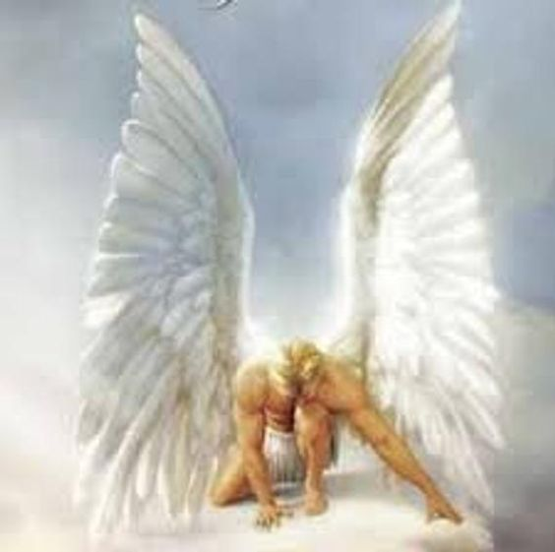
The So-Called Gods was Started By Satan Known as Lucifer who Lifted up his Heart to Be God Yet Not.
It was in Revelations12:7 that all the devils got cast out of heaven and in Matthew10:1-7 us on earth were given authority to cause their imprisonment in hell to wait for judgement day to get cast into the lake of fire. Let's read more
ISAIAH14:13-14 For you have said in your heart, I will ascend into heaven, I will exalt my throne above the stars of God: I will sit also upon the mount of the congregation, in the farthest sides of the north: I will ascend above the heights of the clouds; I will be like the Highest. This is how Lucifer became an usual creature “ekimongwa” thinking total and full foolishness and stupidity to become God.

Slide 58
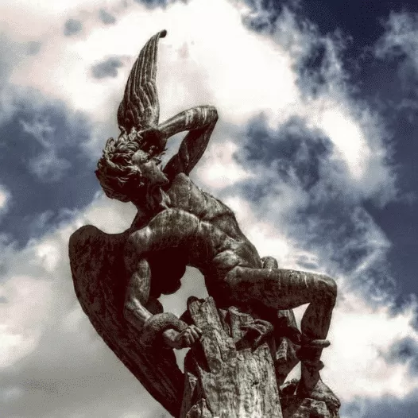
The So-Called Gods was Started By Satan Known as Lucifer who Lifted up his Heart to Be God Yet Not.
Another one may think that God is just emotional, but if among sons of men to call yourself what you are not, you are charged of impersonation then what about to claim you are God, yet you are not. No person impersonates when is going to do something right so even satan to claim that is God, was not going to do right things but promote his evil acts as you see that he never succeeded but bringing people to do evils towards others like murders, meaning that if true could be god, would at least promote righteousness and all sort of goodness as proof.
Let's read more of
ISAIAH14:14-15 I will ascend above the heights of the clouds; I will be like the most High. Yet you shall be brought down to hell, to the sides of the pit.

Slide 59
The So-Called Gods was Started By Satan Known as Lucifer who Lifted up his Heart to Be God Yet Not.
To dwell in principalities, just in the kingdom of the stars can not make you be like God the Father seated in the above heavens. This is a very weak mindset, weaker than that of a young child because a child may think of becoming a father or mother something that happens in the time to come but the thought of becoming God will never happen as one may think of it and instead get cast into hell as Satan in Revelation20:1-3 to fulfill verse 15 of Isaiah14.
The way Satan did it, was to position/place his heart in the throe of God but never even got a chance to access and sit in the throne at any time

Slide 60
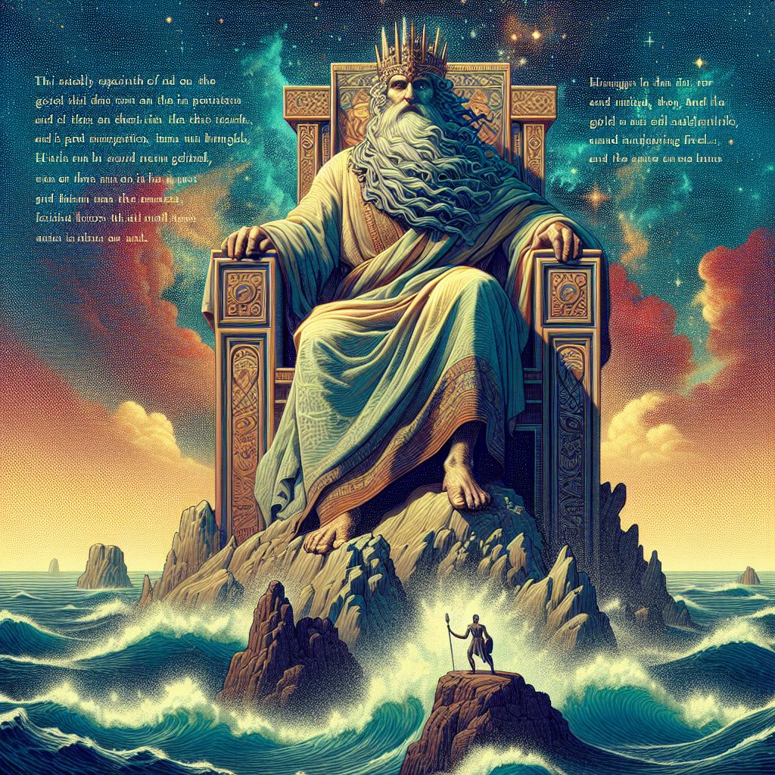
The So-Called Gods was Started By Satan Known as Lucifer who Lifted up his Heart to Be God Yet Not.
According to what we read in
EZEKIEL 28:2 Son of man, say unto the prince of Tyre, Thus says the Lord GOD; Because your heart is lifted up, and you have said, I am a God, I sit in the seat of God, in the midst of the seas; yet you are a man, and not God, though you set your heart as the heart of God: When you look at the reply of God when this foolishness came up in the mind set of Satan, regarded him as a mere person but when the thought became intense, he was called un usual creature according to
ZECHARIAH3:2 And the LORD said unto Satan, The LORD rebuke you, O Satan; even the LORD that has chosen Jerusalem rebuke you: is not this a brand plucked out of the fire?

Slide 61
The So-Called Gods was Started By Satan Known as Lucifer who Lifted up his Heart to Be God Yet Not.
The anointed cherubim are positioned at on the golden alter of God, the beginning of the lake of fire so this one having gotten the foolish thought, fire from this alter consumed him and lost the glory of an anointed cherub becoming deformed that to improve his unusual nature takes blood sacrifices.
In conclusion, those so-called gods is satan and his fallen angels known as the aliens or green men who joined him to fight against God as Genesis3:15-16 and Revelation12:3-4. But praise be to God who said in such times, knowledge of knowing him will increase and those with this knowledge like the Full Knowledge of God will do great things as

Slide 62
Creator is God the Father, God the Word, Jesus Christ and God the Holy Spirit the Three Witnesses.
DANIEL 11:32 And such as do wickedly against the covenant shall he corrupt by flattery: but the people that do know their God shall be strong, and take action. In this ministry of Full Knowledge of God, we are to do great things that include teaching many our God such that they get to know Him and Jesus Christ who gave us the blood of covenant that we should not dishonor by covering it on our businesses but remember it’s the blood that washed and covered our sins.
At the end of this topic, lets recognize it that God the creator is God the Father, God the Word, Jesus Christ and God the Holy Spirit who are the

Slide 63
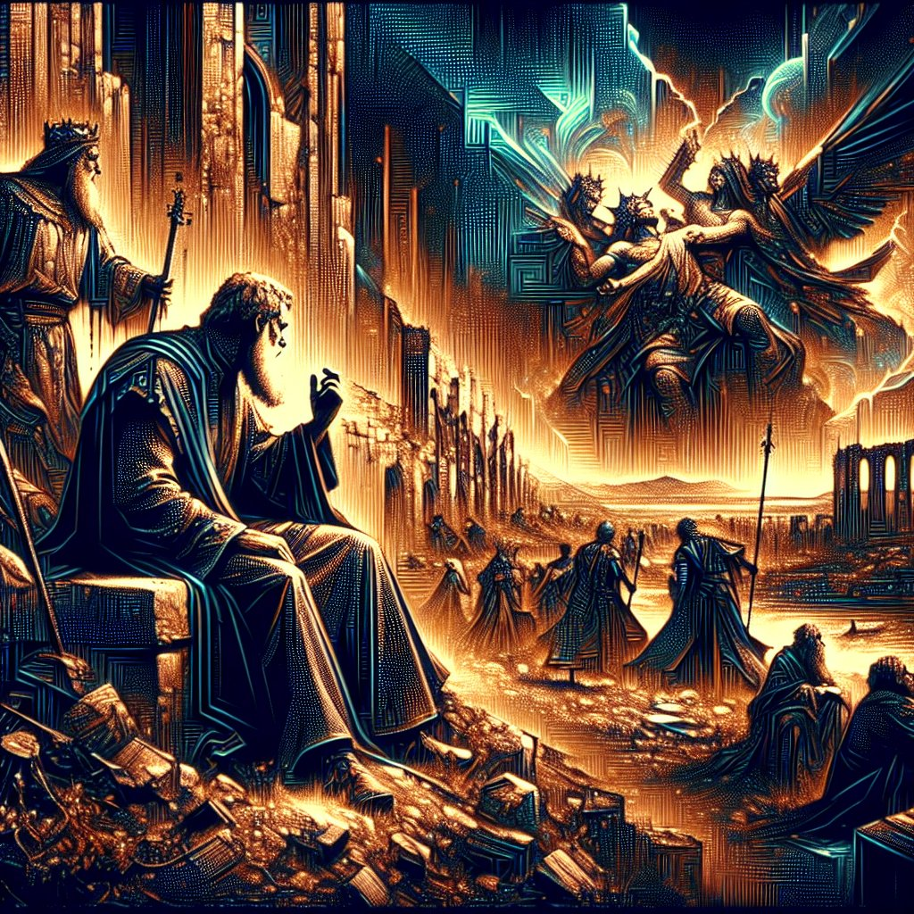
Creator is God the Father, God the Word, Jesus Christ and God the Holy Spirit the Three Witnesses.
Three Witnesses in heavens and above the heavens who existed at the beginning.
JOHN5:7 For there are three that bear witness in heaven, the Father, the Word, and the Holy Spirit: and these three are one. Beyond these three, there is no any other God, they are the Gods who dwell not with sons of men as its spoken of them in the book of Daniel
DANIEL5:11 There is a man in your kingdom, in whom is the spirit of the holy Gods; and in the days of your father light and understanding and wisdom, like the wisdom of the Gods, was found in him. These are Gods the creators of the heavens and earth as we are to see next.

Slide 64

8-DEC-2024 LESSON4: ABOVE THE HEAVENS.
Even now we want to continue with the heavenly journey and the secrets of heavens
SUBTOPIC: Above the heavens, at the beginning before the creation of the heavens and the earth.
This time round we want to study
THE THREE WITNESSES IN HEAVENS AND ABOVE THE HEAVENS AT THE BEGINNING AND THE END.
Recall that to reach here we have covered three lessons which are:
1) The introduction of the above heavens, the beginning as Ephesians4:6 and Ephesians4:9-10.

Slide 65
There are only three witnesses in heavens and above heavens from the beginning
2) God the beginning and the end, the first and last, alpha and omega
3) God the creator basing in the above heavens, at the beginning as Genesis1:1 and Jeremiah10:11.
Therefore, we want now to focus on the three witnesses at creation of all things to answer the question we got, who is the God who created as we hear in
GENESIS1:1 In the beginning God created the heavens and the earth. We see that God created the heavens and earth, but to get explained of the creation, we need those who existed to witness what happened.
This is God the Father, God the Word and God the Holy Spirit, the three

Slide 66
There are only three witnesses in heavens and above heavens from the beginning
Witnesses of what was before creation, the creation of heavens and earth and what to come once the heavens and earth are removed according to
1JOHN5:7 For there are three that bear witness in heaven, the Father, the Word, and the Holy Spirit: and these three are one. This is not only in heavens but also in the above heavens at the beginning. These are the only ones who existed before creation of the heavens and the earth, so they are the only one to give evidence on things before, those which are and those to come.
This is the origin of what is said that in the mouth of two or three a matter

Slide 67

There are only three witnesses in heavens and above heavens from the beginning
Will get established according to
MATTHEW18:16 But if he will not hear you, then take with you one or two more, that in the mouth of two or three witnesses every word may be established. To every scripture of God, there should be a back up from any of these three to say that a voice of two or three should be heard on a particular point
Example: Genesis1:1 says that at the beginning God created the heavens and earth and this is God the Father but verse two shows the Holy Spirit was there at the beginning Genesis1:2 And the earth was without form, and void; and darkness was upon the face of the deep. And the Spirit of God moved upon the face of the waters.

Slide 68
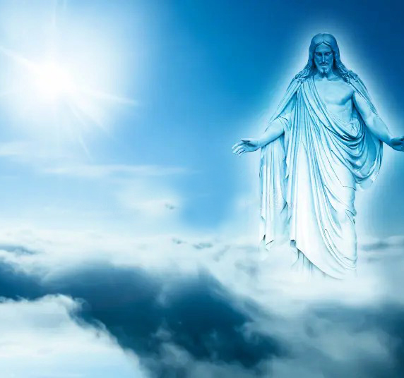
There are only three witnesses in heavens and above heavens from the beginning.
At the beginning during creation, only the creators where there that is why Psalms 104:30 says the spirit is sent and they are created thus also creator. The third witness at the beginning during creation comes in, Our Lord Jesus the Word of God in John1:1 that in the beginning was the Word, the Word was with God and the Word was God by whom all things were created.
That is how the two or three witnesses cause the establishment of a matter
2CORINTHIANS13:1 This is the third time I am coming to you. In the mouth of two or three witnesses shall every word be established.

Slide 69
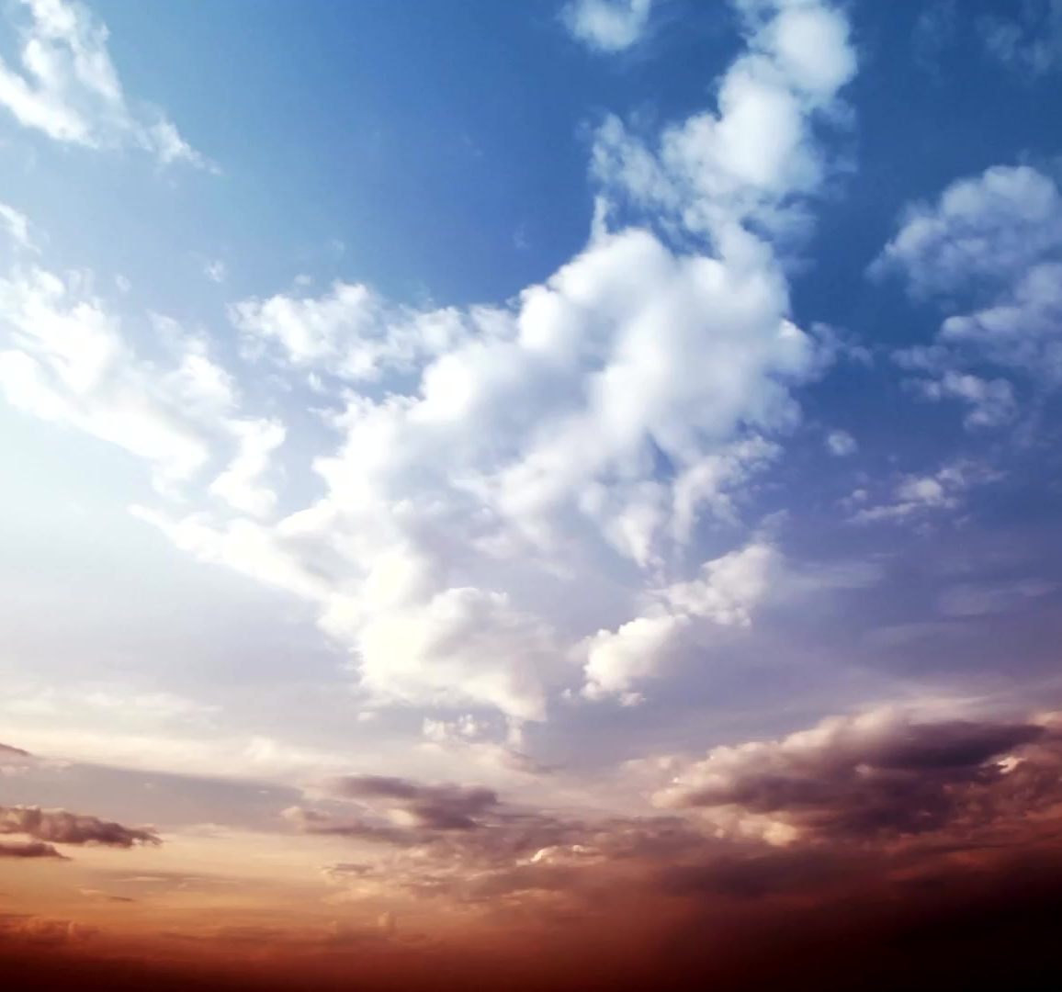
The first witness God the Father at the beginning in above heavens.
So truly in heaven and above heavens, we have these three to witness any thing we require on what was before creation, at creation and what to come once the heavens and earth are removed.
God the Father as the first witness was there at the beginning in above heavens.
EPHESIANS4:6 One God and Father of all, who is above all, and through all, and in you all. Being above the heavens, the Holy Spirit continues to witness that indeed the Father dwells in above the entire heavens and bases there to see all things in heavens and earth according to the book of Job.

Slide 70
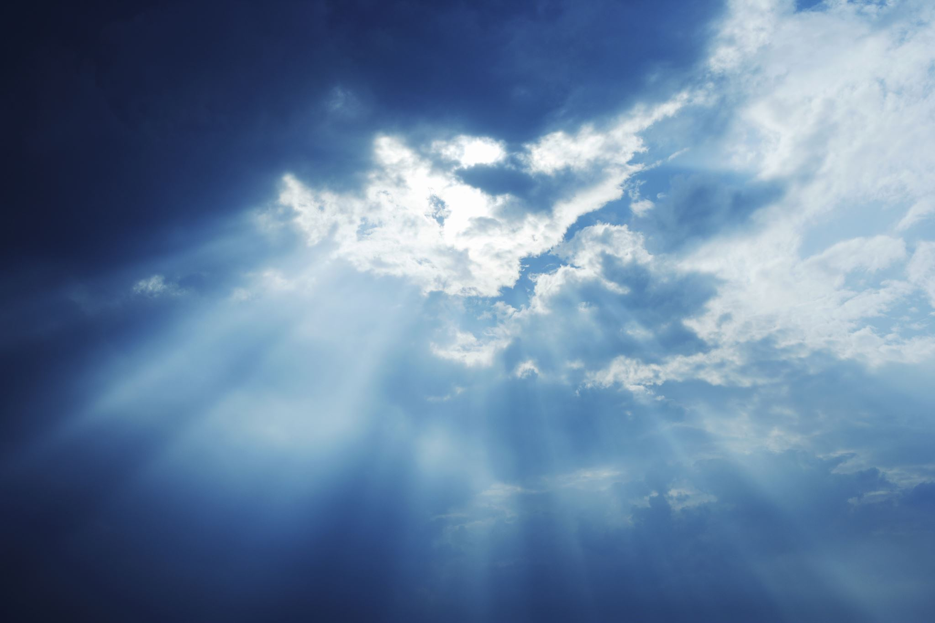
The first witness God the Father at the beginning in above heavens.
JOB28:23-24 God understands its way, and he knows its place. For he looks to the ends of the earth, and sees under all the heavens;
He was not alone there but was God the Word at the beginning according to
JOHN1:1-2 In the beginning was the Word, and the Word was with God, and the Word was God. The same was in the beginning with God. They surely existed and these three have their own witness, not a witness with them but one who gives witness on the existence of the three at the beginning, Apostle Ronald Hope Witness as the promise of God in Revelations11:3

Slide 71

The second witness God the Word who is Jesus at the beginning.
And I will give power unto my two witnesses, and they shall prophesy a thousand two hundred and three score days, clothed in sackcloth. One is the anointment of Moses to see the heavens and their fullness, yet another is the anointment of Elijah to fight against the false prophets and prepare the coming of Jesus.
God the Word, Lord Jesus comes in to witness his existence with God the Father at the beginning and starts this through the mouth of Solomon.
PROVERBS 8:22-23 The LORD possessed me in the beginning of his way, before his works of old. I was set up from everlasting, from the beginning, before the earth was.

Slide 72
The second witness God the Word who is Jesus at the beginning.
This voice is of one spoken of in John1:1 who existed with God the Father who is the Word, Lord Jesus who shows that indeed was at the beginning with God. He is the one who requested back for the glory in which he was with God the Father according to
JOHN17:4-5 I have glorified you on the earth: I have finished the work which you gave me to do. And now, O Father, glorify me with your own self with the glory which I had with you before the world was. This explains Ephesians4:6 that God the Father was not alone but was with Christ as the Word of God who left back this glory when coming on earth clothing flesh as humans, lets read.

Slide 73
The second witness God the Word who is Jesus at the beginning.
JOHN1:14 And the Word clothed flesh, and dwelt among us, (and we beheld his glory, the glory as of the only begotten of the Father,) full of grace and truth. This is God the Word whom we saw with God the Father and when He was coming on earth, put out all his glory and put on human flesh that had no component of sin to be able cover the sin in the human flesh. Let's see how God the Word left the heavenly glories as God
PHILIPPIANS2:5 Let this mind be in you, which was also in Christ Jesus: Sometimes you may be of great honor, but a condition may come when you only need to humble yourself to a level of a servant like Christ who had the authority to release and retain life but to save us decided to leave life go.

Slide 74
The second witness God the Word who is Jesus at the beginning.
Let's read more.
PHILIPPIANS2:6-7 Who, being in the form of God, thought it not a thing to be grasped to be equal with God: But made himself of no reputation, and took upon him the form of a servant, and was made in the likeness of men. Having reached on earth, Christ walked as a child before God the Father that he had to ask in prayer for what he needed and on addition showed there are things he knew not but God the Father to a level of saying God the Father is greater than him yet they all had the same glory thus equal. Let's read more
PHILIPPIANS2:8-9 And being found in fashion as a man, he humbled himself, and became obedient unto death,

Slide 75
The second witness God the Word who is Jesus at the beginning.
even the death of the cross. Therefore, God also has highly exalted him and given him a name which is above every name. This pleased much God the Father, Christ had all authority as God the Father but decided to go humble and to come on earth, came into his own territories but due to the lowered glories, was not recognized.
JOHN1:10-11He was in the world, and the world was made by him, and the world knew him not. He came to his own territories, and his own believed him not. Christ Jesus is the owner of all these territories but to own them, he created them thus existed before creation of heavens and earth with God the Father. Not only the spirit witnesses the

Slide 76
The second witness God the Word who is Jesus at the beginning.
of Christ at the beginning, God the Father witnesses this that Jesus is God with everlasting throne.
HEBREWS1:8 But unto the Son he says, Your throne, O God, is forever and ever: a scepter of righteousness is the scepter of your kingdom. Even though Christ was here on earth as a son and servant, before God the Father was still God with a well-established throne. The Holy Spirit also confirmed this, one who came on earth was God according to
1TIMOTHY 3:16 And without doubt great is the mystery of godliness: God was manifest in the flesh, justified in the Spirit, seen of angels, preached unto the Gentiles, believed on in the world, received up into glory.

Slide 77
The third witness who is the Holy Spirit right from the beginning.
One of the mystical way of fearing God is to acknowledge that one who came on earth is God, Jesus Christ and he is the Word of God who appeared to the prophets in the old testament.
Now concerning the third witness in heavens and above the heavens, God the Holy Spirit, he was also there at the beginning according to:
GENESIS1:1-2 In the beginning God created the heavens and the earth.
And the earth was without form, and void; and darkness was upon the face of the deep. And the Spirit of God moved upon the face of the waters. This means concerning things of creation, is a good witness since he was there before the creation and he was among those who

Slide 78
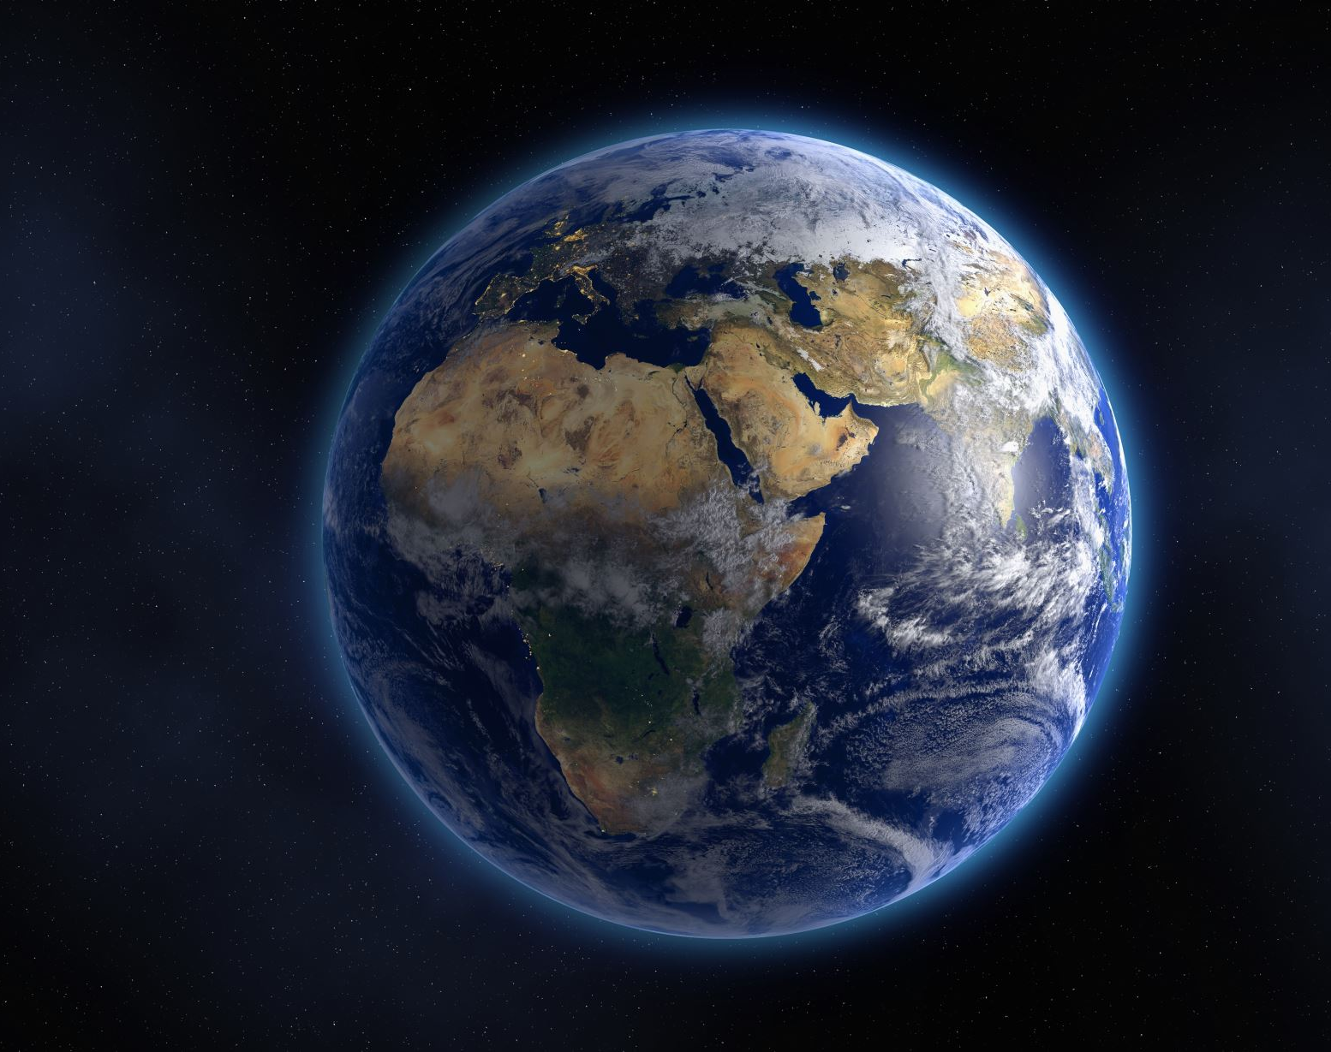
Prove that the three witnesses have all time been in existence and they will always be
created according to
PSALMS104:30 You send forth your Spirit, they are created: and you renew the face of the earth. If you are to send some one to create, should be a creator therefore we can not deny it that the holy spirit is one of the witnesses in the heavens and above the heavens.
The three witnesses have all time been in existence and they will always be as proven by the scriptures each of them giving witness on the other.
JOHN16:13-15But when he, the Spirit of truth, is come, he will guide you into all truth: for he shall not speak of himself; but whatsoever he shall hear, that shall he speak and he will show you things to come.

Slide 79
Prove that the three witnesses have all time been in existence and they will always be
He shall glorify me: for he shall receive of mine and shall show it unto you. All things that the Father has are mine: therefore, said I, that he shall take of mine, and shall show it unto you. The scripture involves the three and we see them knowing the same things of which are to come when the heavens and earth are removed thus, they witness things in heavens and above the heavens.
Furthermore we see them in Matthew that once when one was baptized, the three were present and manifested their existence.
MATTHEW3:16-17 And Jesus, when he was baptized, went up immediately out of the water:

Slide 80

Prove that the three witnesses have all time been in existence and they will always be
and, lo, the heavens were opened unto him, and he saw the Spirit of God descending like a dove, and lighting upon him: And lo a voice from heaven, saying, This is my beloved Son, in whom I am well pleased.
We see that as one was being baptized in the waters, the second appeared onto him basing in a dove and the third one spoke basing in the heavens and this proves Matthew28 that once baptized we enter into the three
MATTHEW28:19 Go you therefore, and make disciples of all nations, baptizing them in the name of the Father, and of the Son, and of the Holy Spirit:

Slide 81
Prove that the three witnesses have all time been in existence and they will always be.
Physically we shall enter into God the Father when our Lord Jesus will lead us back at the beginning in the new heavens and new earth where the three exist so we shall dwell in them, but now through baptism we get started on this preparations of returning back. So this is how things were at the beginning that we dwelt in him the Father as Psalms90
May God bless you for this lesson.

Slide 82
11-DEC-2024 LESSON5: ABOVE THE HEAVENS.
Even now we want to continue with the heavenly journey and the secrets of heavens
SUB TOPIC: Above the heavens, at the beginning before the creation of the heavens and the earth.
This time round we want to study
THE IMAGE AND THE LIKENESS OF THE THREE WITNESSES IN THE HEAVENS AND ABOVE THE HEAVENS AT THE BEGINNING.
NOTE: How do they look like? This is the image and the likeness of God the Father, God the Word who is the son Jesus Christ and God the Holy Spirit known as the spirit of the Lord.

Slide 83
God Refuses Us To Make Any Image or Form But Only Know His Glorious Image.
Failure to know the image and likeness of these three witnesses results to not understanding the scripture in
EXODUS20:3 You shall have no other gods before me. We see that the living God expects us not to have any other thing called god but to fulfill this, we need to be knowing the image and the likeness of the true God such that we differentiate him from all those who come claiming to be god thus its this topic and at end we make no other image physically and in our hearts and brains as
EXODUS20:4 You shall not make unto yourself any graven image, or any likeness of any thing that is in heaven above, or that is in the earth beneath, or that is in the water under the earth:

Slide 84
God Refuses Us To Make Any Image or Form But Only Know His Glorious Image.
We see that none is allowed to make an image, those in heavens like the angels, righteous and rest in realms above, those on earth in the realms below in the fourth heaven and those below the earth meaning that if we are to have the image of God should be the image and likeness at the beginning in the above heavens. This is right that we see even Christ Jesus in John17:4-5 requested for the glory in which he was in before creation of earth and heavens at the beginning. Lets read on
EXODUS20:5 You shall not bow down yourself to them, nor serve them: for I the LORD your God am a jealous God, visiting the iniquity of the fathers upon the children unto the third and fourth generation of them that hate me.

Slide 85
God Refuses Us To Make Any Image or Form But Only Know His Glorious Image.
To have any other image is an abomination and an automatic crime before God and the reason why God told us to not make these images, its very hard and so difficulte to make the image of God as we are going to see, for his image is living and so glorious that even the stones to use are not here on earth.
According to God, those who do images are corrupted and foolish as
DUETRONOMY4:16 Lest you act corruptly and make for yourselves a carved image in the form of a male and female. You find a person basing in this scripture to say that its contradicting with Genesis1:26-27 forgetting that one who made the image was God not man and above

Slide 86
God Refuses Us To Make Any Image or Form But Only Know His Glorious Image.
that, the image that God made is of man with life not as those humans make. So all those hiding in this scripture that even God made an image, the command is for us not to make because we can not do it as him who designed the image of man and woman with proper systems like digestive, respiratory, circulatory and others.
N.B: The image in which God created Adam was not as perfect as the image of God but still man fall and entered a more Feke image of the earthly body of death having a storage tank of stool and urine.
DUETERONOMY 4:17-19 The likeness of animal that is on earth, likeness of any winged bird that flies in the air, likeness of anything that creeps on the ground or likeness of fish

Slide 87
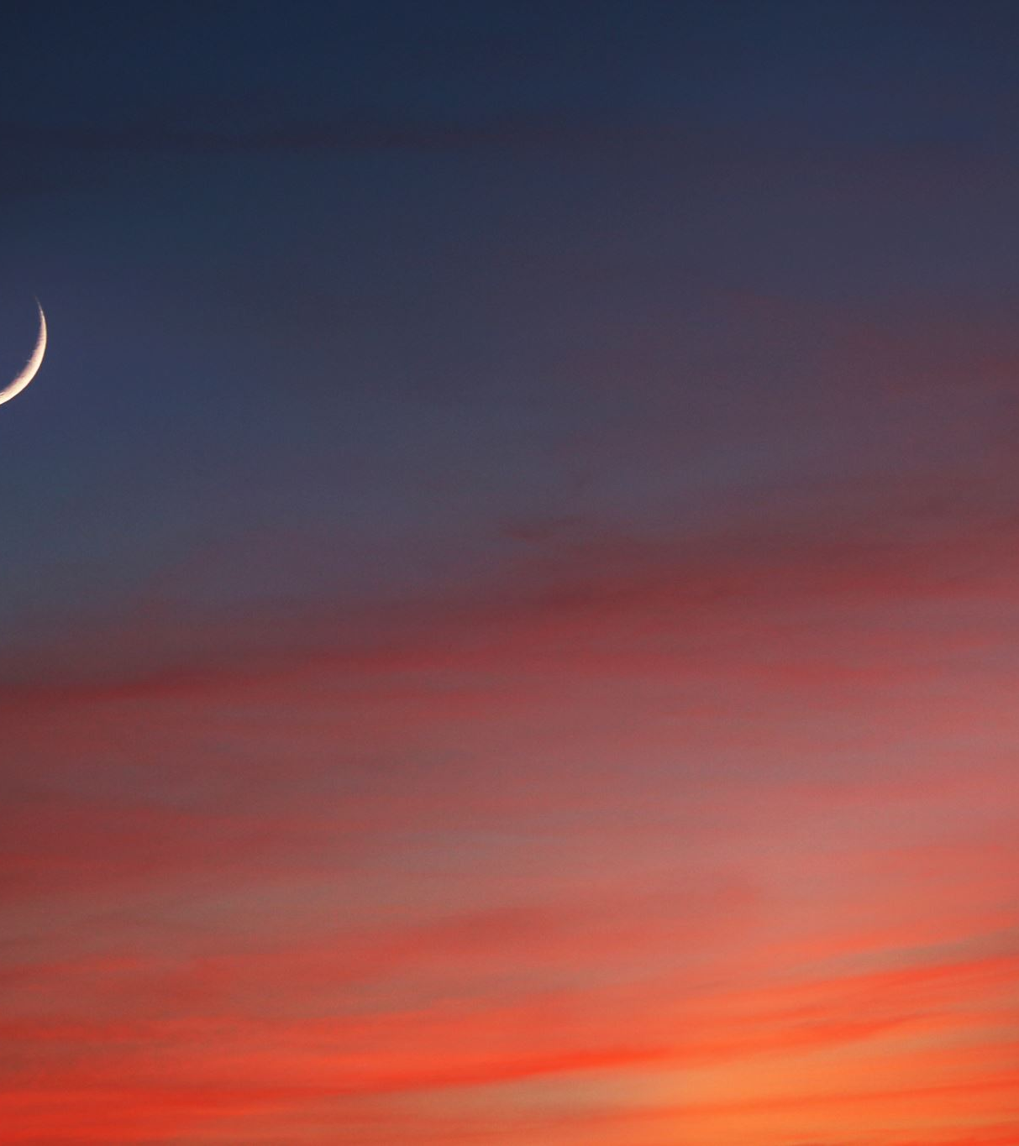
God Refuses Us To Make Any Image or Form But Only Know His Glorious Image.
And take heed, lest you lift your eyes to heaven and when you see the sun, the moon and the stars, all the hosts of heavens, you feel driven to worship them and serve them, which the Lord your God has given to all people under the whole heavens as a heritage.
God rejected us from making images of 24 elders, 4 living creatures, anointed cherubim and holy angels such that we worship not any of these, you find that he only allows us to write down the revelations and visions of these things for study and understanding purposes as Habakkuk2:2 but not to worship. What is surprising is that even the angel who appeared in the glory of God, only fire was seen not his image according to

Slide 88
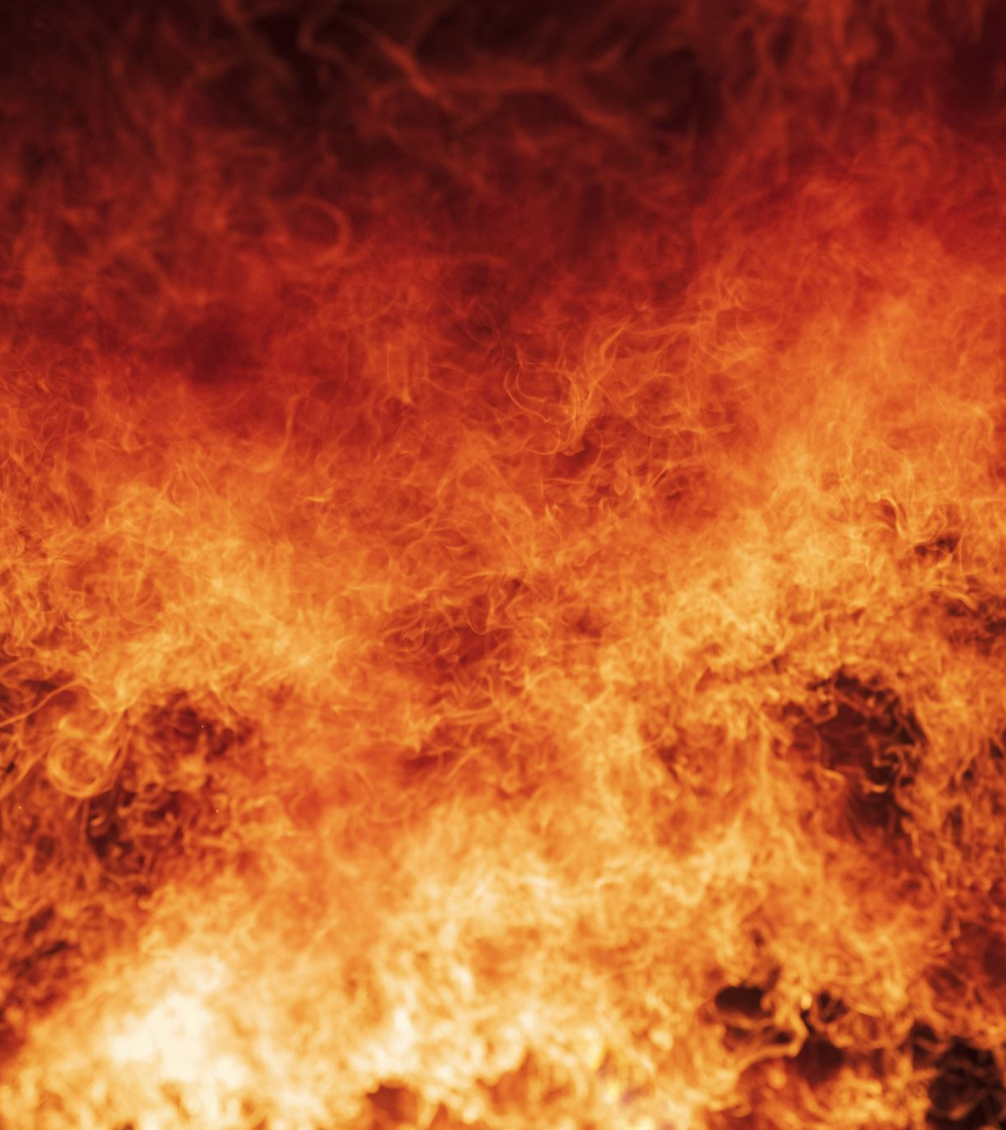
God Refuses Us To Make Any Image or Form But Only Know His Glorious Image.
DUETERONOMY 4:15 Take careful heed to yourselves, for you saw no form when the Lord spoke to you at Horeb out of the midst of fire. Even though this angel appeared to them in the name of God, they saw no his image but just fire with a purpose of not worshiping as in Revelations22:8-9 that when John saw the greatness of an angel felt worshiping but the angel told him to worship God.
Whenever we form images, we end up casting God from our midst and inside us as his temples according to
EZEKIEL8:5-6 And behold northward at the gate of the altar this image of jealousy in the entrance.

Slide 89
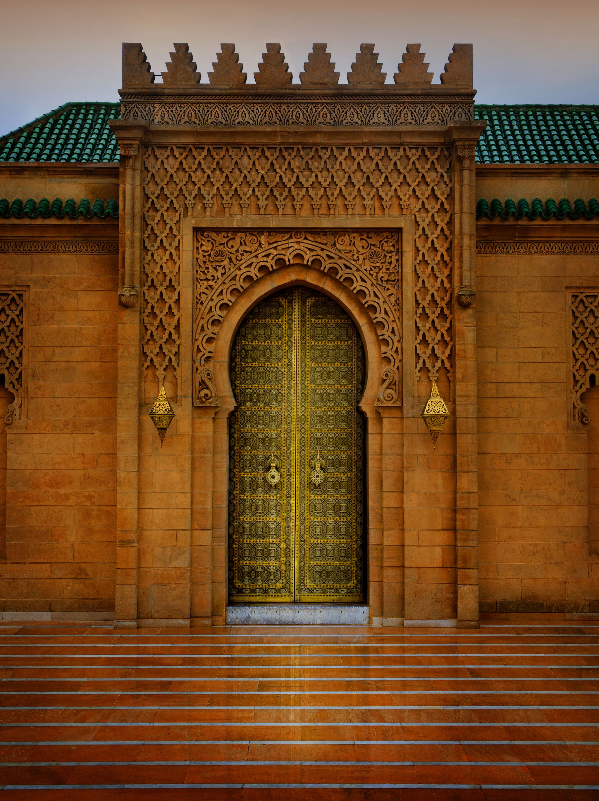
God Refuses Us To Make Any Image or Form But Only Know His Glorious Image.
He said furthermore unto me, Son of man, see you what they do? even the great abominations that the house of Israel commits here, that I should go far off from my sanctuary? This is very important that in the time past, the holy sanctuary was the building temple of the name of God but the temple was changed to be people as 1Corinthians3:9-16 and 1Corinthians6:19-20 but people have false images of God in their hearts and minds something very deadly.
EZEKIEL8:10 So I went in and saw; and behold every form of creeping things, and abominable beasts, and all the idols of the house of Israel, portrayed upon the wall round about.

Slide 90
God Refuses Us To Make Any Image or Form But Only Know His Glorious Image.
Time reached that in nations like India and other Asian countries made these things thinking are on the living God yet they are becoming foolish before God. Among the many images of the things worshiped, what is the true image that all of us may worship?
EZEKIEL 8:11 And there stood before them seventy men of the elders of the house of Israel, and in the midst of them stood Jaazaniah the son of Shaphan, with every man his censer in his hand; and a thick cloud of incense went up. Some in religions are burnt incense that its God,
So to worship what seems great in the eyes of people, is inside them so God has brought this topic to us to have His true image and likeness and: On the image and likeness of God, God explains it like this:

Slide 91
With the likeness and image of God the Word, the son Jesus Christ gives the expressed image of the invisible God the Father.
God the Word who is the son Jesus Christ is the expressed image of the invisible God ( God the Father and God the Holy Spirit).
Once you get the image and likeness of Lord Jesus, you then have known that of God the Father according to:
JOHN14:7 If you had known me, you would have known my Father also: and from henceforth you know him, and have seen him. If we are to know and understand the image of God the Father, we look at how Lord Jesus appears then we answer the worries and doubts as Philip in
JOHN14:8 Philip said unto him, Lord, show us the Father, and it will satisfy us.

Slide 92
With the likeness and image of God the Word, the son Jesus Christ gives the expressed image of the invisible God the Father.
He had not understood verse7 but still when we look at the answer of Christ was not different from what he had spoken before
JOHN14:9 Jesus said unto him, Have I been so long a time with you, and yet have you not known me, Philip? he that has seen me has seen the Father; and how say you then, Show us the Father? Now the worry among the apostles, does God appear in flesh since they had seen Christ in flesh walking with them. They had to think of the glorious body since even apostle Paul who saw Christ, developed doubt if was in the body or not according to
2CORINTHIANS 12:1-2I knew a man in Christ fourteen years ago,

Slide 93
God has his heavenly glorious body in which he appears but not like the flesh of humans
(whether in the body, I cannot tell; or whether out of the body, I cannot tell: God knows;) such a one caught up to the third heaven. There was confusion to apostle Paul since he had gone to heaven in vision but as time went by in the heavenly journey, realised that Christ was in the Godly glorious body not the common body as the scripture in
PHILIPPIANS3:20-21 For our citizenship is in heaven; from which also we look for the Savior, the Lord Jesus Christ: Who shall change our humble body, that it may be fashioned like unto his glorious body,

Slide 94
God has his heavenly glorious body in which he appears but not like the flesh of humans
When you look at verse21, he got revealed that indeed Christ was in the body a thing he had not understood in 2 Corinthians12:2 but on father more, he said it was a body of much godly glory not these human week bodies. Apostle Paul proves this that it was through being taught by God about this glorious body just as in the seven years heavenly journey
GALATIANS1:11-12 But I make known to you, brethren, that the gospel which was preached by me is not according to man. For I neither received it of man, neither was I taught it, but by the revelation of Jesus Christ.

Slide 95
God has his heavenly glorious body in which he appears but not like the flesh of humans
Recall it was in the revelations of Christ that was shown one in the third heaven and failed to understand the nature of the body but with the teachings in revelations of Lord Jesus was able since the promises in John14:6-8 had shown once we get to know Jesus the Word of God, we shall be knowing God the Father. This was true that having gotten this, apostle Paul came back and said they know Christ not as before according to
2CORINTHIANS5:16 Therefore from now on know we no man after the flesh: yea, though we have known Christ after the flesh, yet from now on know we him no more.

Slide 96
God has his heavenly glorious body in which he appears but not like the flesh of humans
This clearly shows that all images of flesh used like when on the cross are no longer of value because Jesus is not dead but living and left the cross long time as Revelations1:18.
Recall that when Jesus was coming on earth, He had to unclothe the Godly glorious body and came in the earthly body of lower glory and quality as a human servant according to the scriptures in Philippians2:5-10 lets read
PHILIPPIANS2:6-7 Who, being in the form of God, thought it not a thing to be grasped to be equal with God: But made himself of no reputation, and took upon him the form of a servant, and was made in the likeness of men:

Slide 97
God has his heavenly glorious body in which he appears but not like the flesh of humans
so for this reason, had to request back his glorious body in which he dwelt in at the beginning as
JOHN17:4-5 I have glorified you on the earth: I have finished the work which you gave me to do. And now, O Father, glorify me with your own self with the glory which I had with you before the world was. This glory spoken of is the glorious body of God. By this glorious body, the true image of God the Father and Holy Spirit is known and revealed to us as the scriptures explain that so Christ Jesus is the expressed image of invisible God.

Slide 98
Christ Jesus is the expressed image of invisible God the Father.
Lets read
HEBREWS1:2-3 Has in these last days spoken unto us by his Son, whom he has appointed heir of all things, by whom also he made the worlds;
Who being the brightness of his glory, and the express image of his person. It’s the son who brings out the actual brightness of God the Father and his real image/expressed or actual and exact image and likeness therefore once we reach at the appearance of Jesus the Word of God, we will have known the likeness and image of other two as more is given in
COLOSIANS1:12-15Who is the image of the invisible God, the firstborn of all creation:

